Slide 1
OUR HOBBIES & FAVES
FESTIVALS AROUND EUROPE
PUPILS OF 6TH GRADE
PAMFILA PRIMARY SCHOOL
LESVOS,GREECE
2015-16

Slide 2
HI! We are Eve and Mirsini? Can you Guess our common faves?

Slide 3
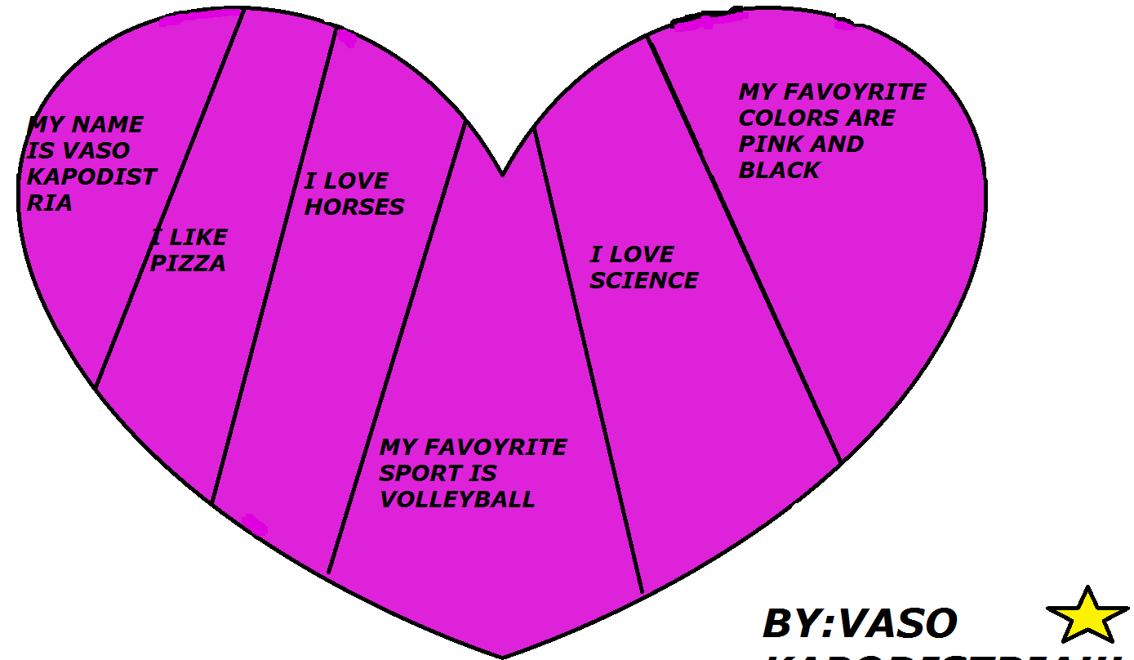
☺We’re Vaso, Irene and Evi. We have the same interests. What are they?

Slide 4
We are Billy and Bill!!
We like the same things.
Guess what?

Slide 5
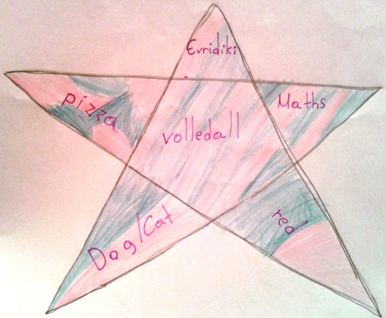
We are ELIZABETH and EVRIDIKI.
What are our common interests?Find them in the WORD CLOUD!

Slide 6
Hi! I’m Stratis and I’m Panos.
Look and find our hobbies and likes!

Slide 7
We are Fotini, Mary and Johanna! These are our hobbies!☺

Slide 8
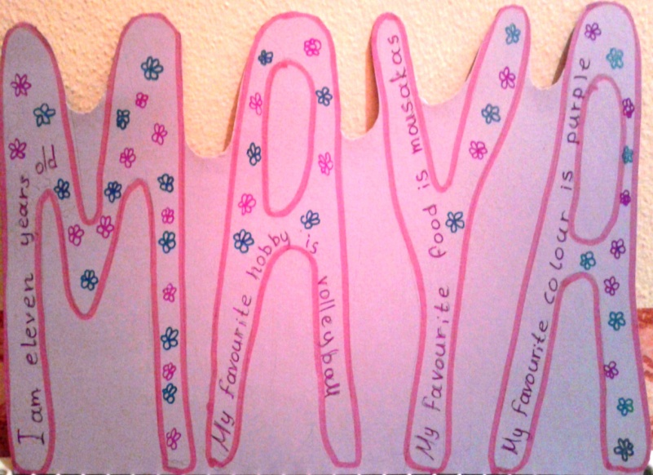
Hello☺! We’re Maya and Anastasia! We’re best friends! Can you guess our Favourite things?

Slide 9
I’m Nick and I’m Peter. We are friends. This is our WORD CLOUD with our hobbies.

Slide 10
Hi! WE’re Mary and Antigoni. We play together and these are our FAVES! Guess what we like most!

Slide 11
Hi everybody! We are Taxiarhis and Solon. We think you can guess what we like best!

Slide 12
☺ We are Magdalene and Joanna and we are best friends. This is our hobbies in a word cloud!!!

