Slide 1
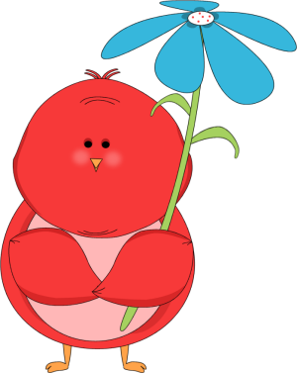
Will
or
be going to?
Start!

Slide 2
I think this school year … be great!
will
is going to

Slide 3
I … work hard this school year!
I promise!
will
am going to

Slide 4
Look at the clouds! It … rain soon!
will
is going to

Slide 5
I … tell anyone.
You can trust me.(=εμπιστευτείς)
won’t
am not going to

Slide 6
Be careful! You … fall down!
will
are going to

Slide 7
If you are thirsty,
I … buy some juice for you.
will
am going to

Slide 8
We … visit our
friends next summer.
We have planned it.
will
are going to

Slide 9
I … help you with your
project, I promise!
will
am going to

Slide 10
Look! Jane … jump into
the swimming pool !
will
is going to

Slide 11
I am tired. I … go to bed.
will
am going to

Slide 12
Someone is at the door.
Don’t stand up, I … open it.
will
am going to

Slide 13
WELL DONE!

