Slide 1
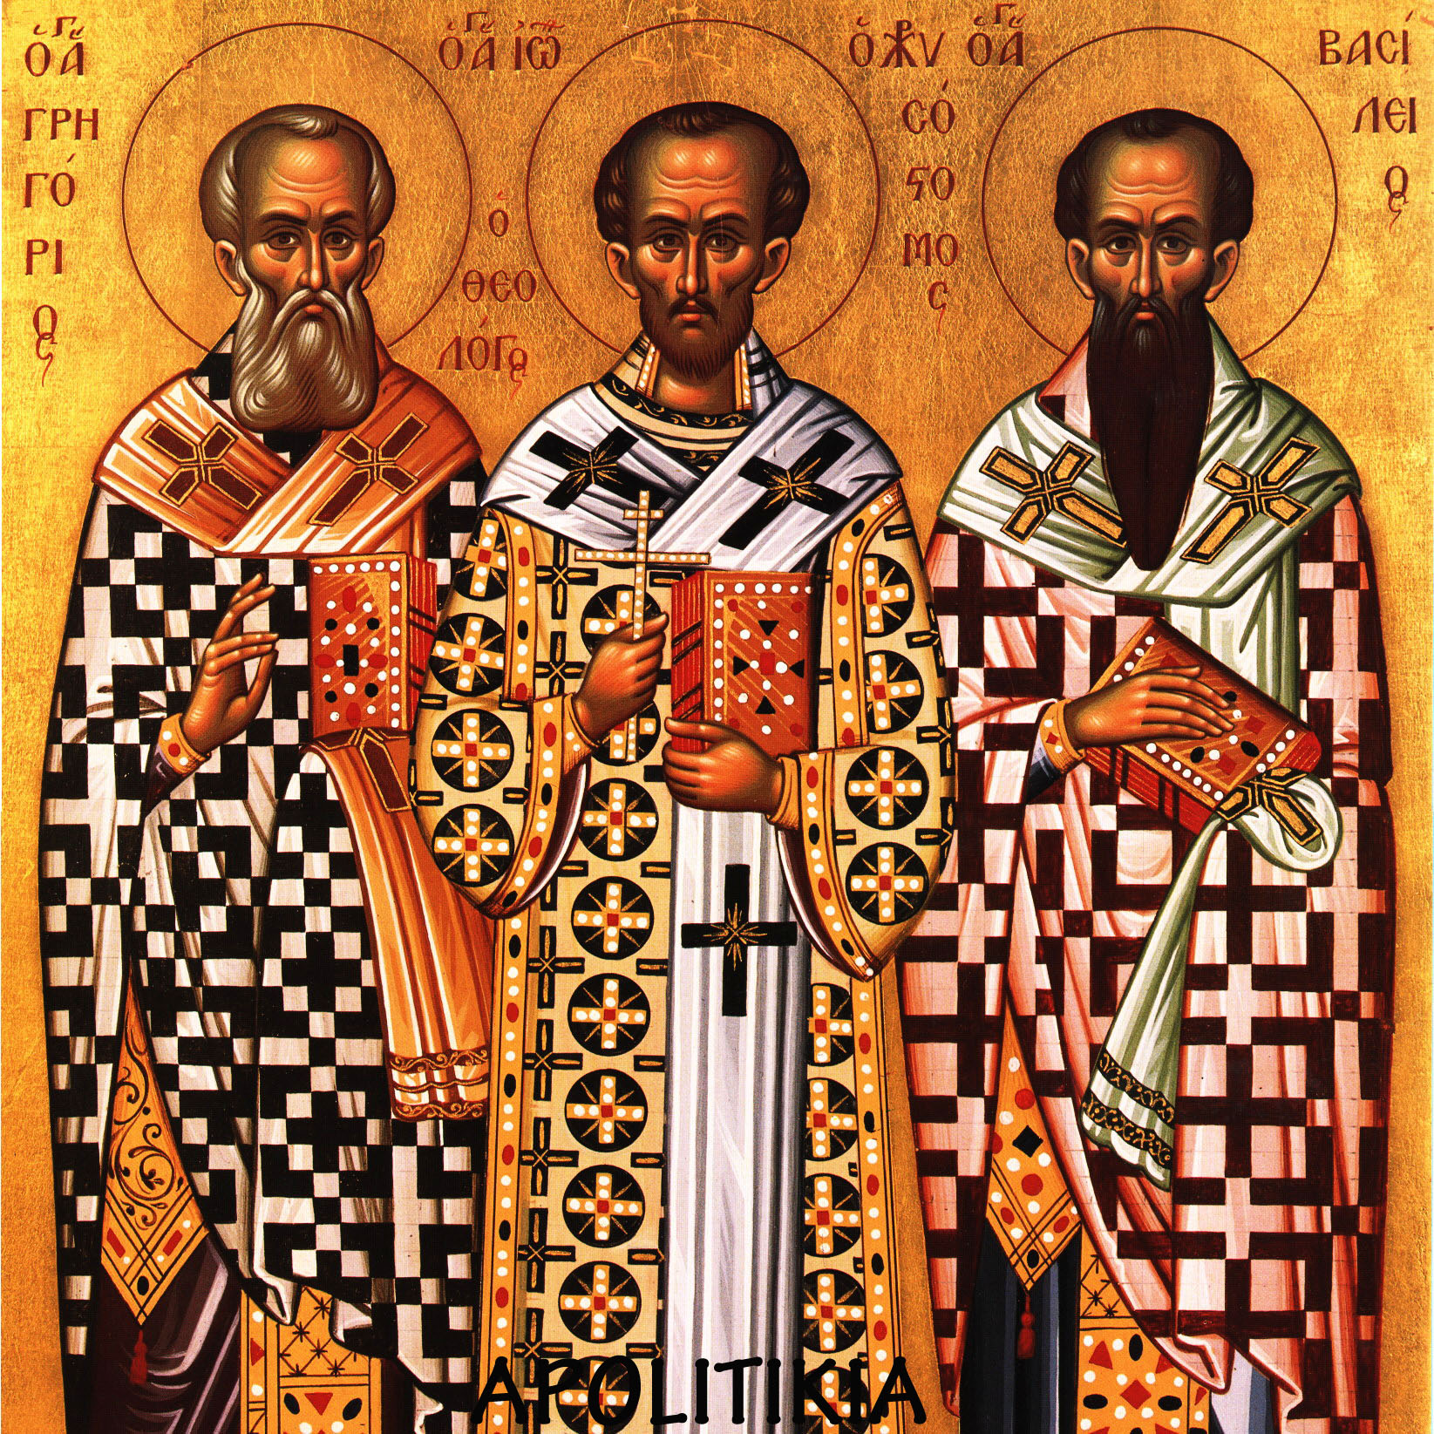
THE THREE HIERARCHS: A SCHOOL HOLIDAY

Slide 2
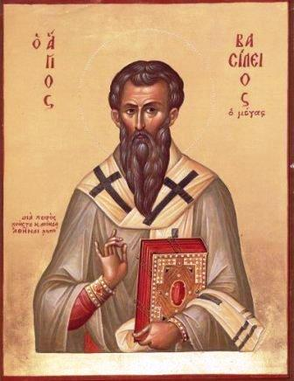
ST. BASIL THE GREAT

Slide 3
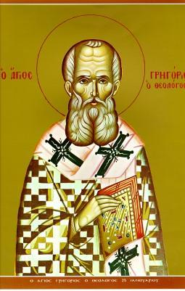
ST. GREGORY THE THEOLOGIAN

Slide 4
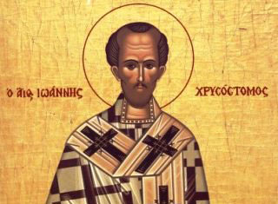
ST. JOHN CHRYSOSTOM

Slide 5
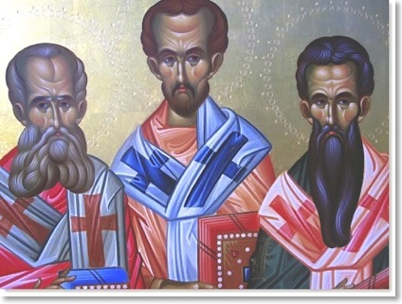
THE THREE HIERARCHS WERE AMONG THE GREATEST TEAGHERS

Slide 6
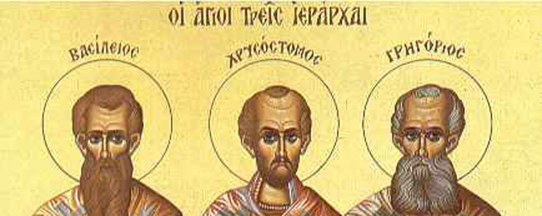
THE THREE HIERARCHS FOLLOW THE BIBLE AND SAY : “DO NOT FORGET TO DO GOOD AND TO SHARE WITHOTHERS”

Slide 7
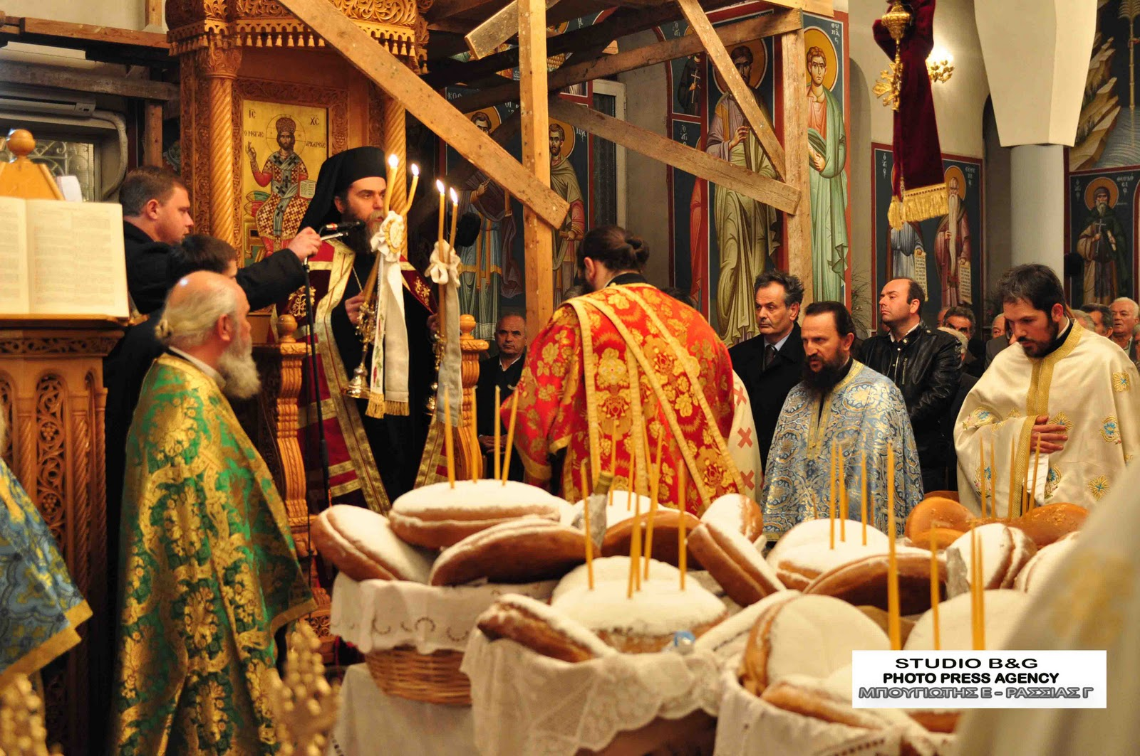
WE CELEBRATE THE FEAST OF THE THREE HIERARCHS TOGETHER ON 30th JANUARY

Slide 8
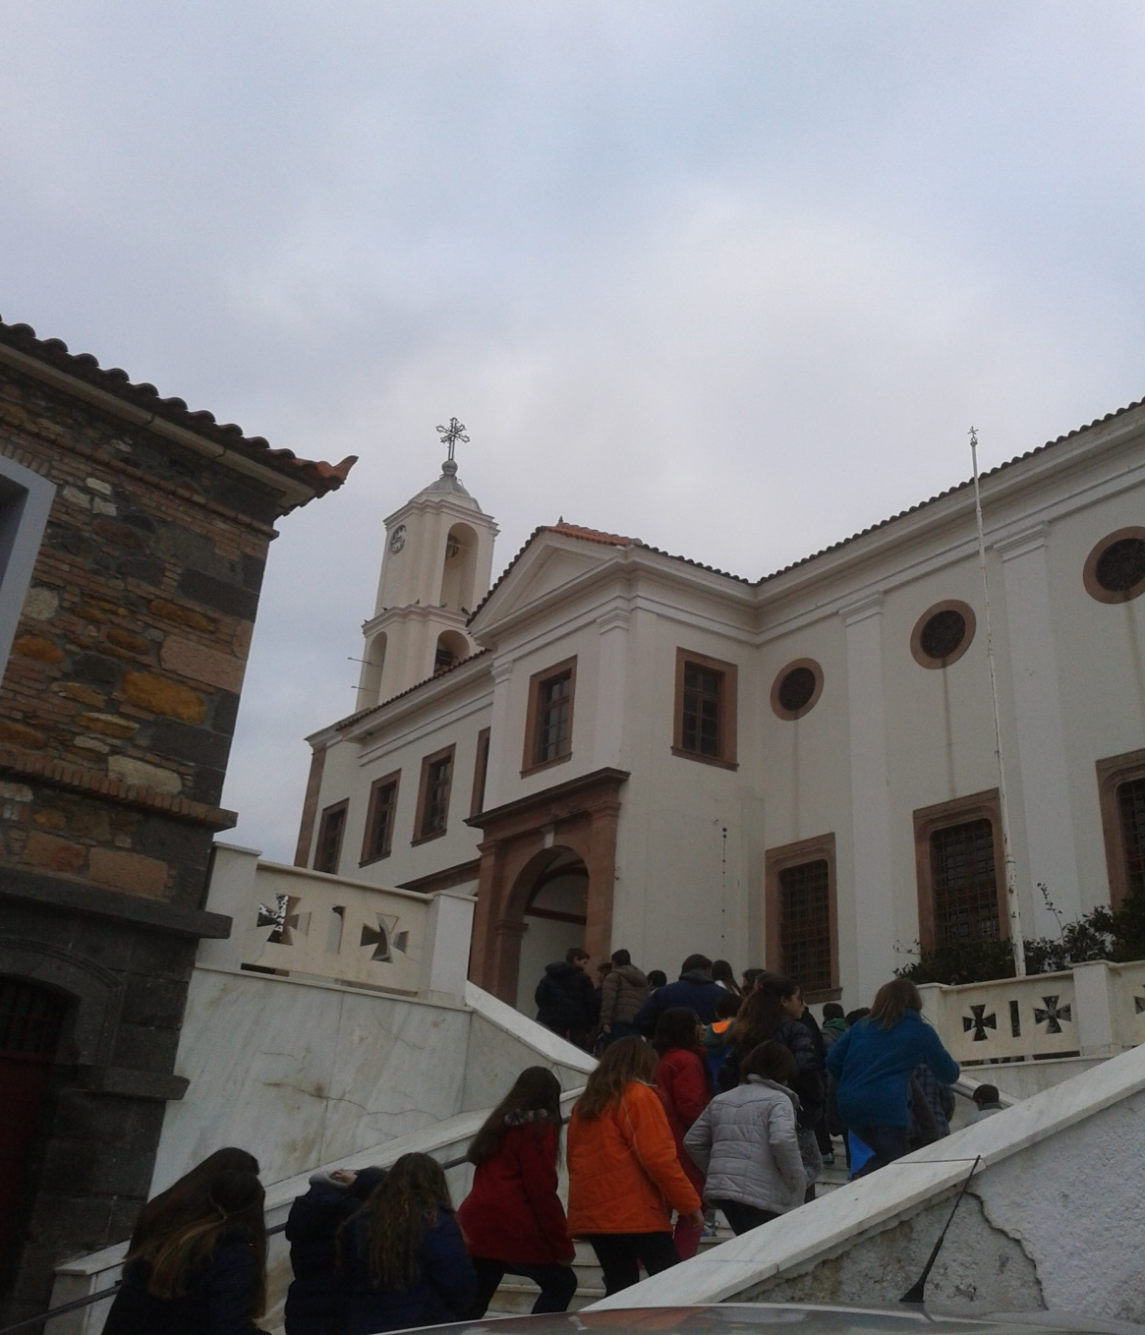
ON THAT DAY THE PUPILS GO TO CHURCH AND LISTEN TO THE LITURGY.

Slide 9
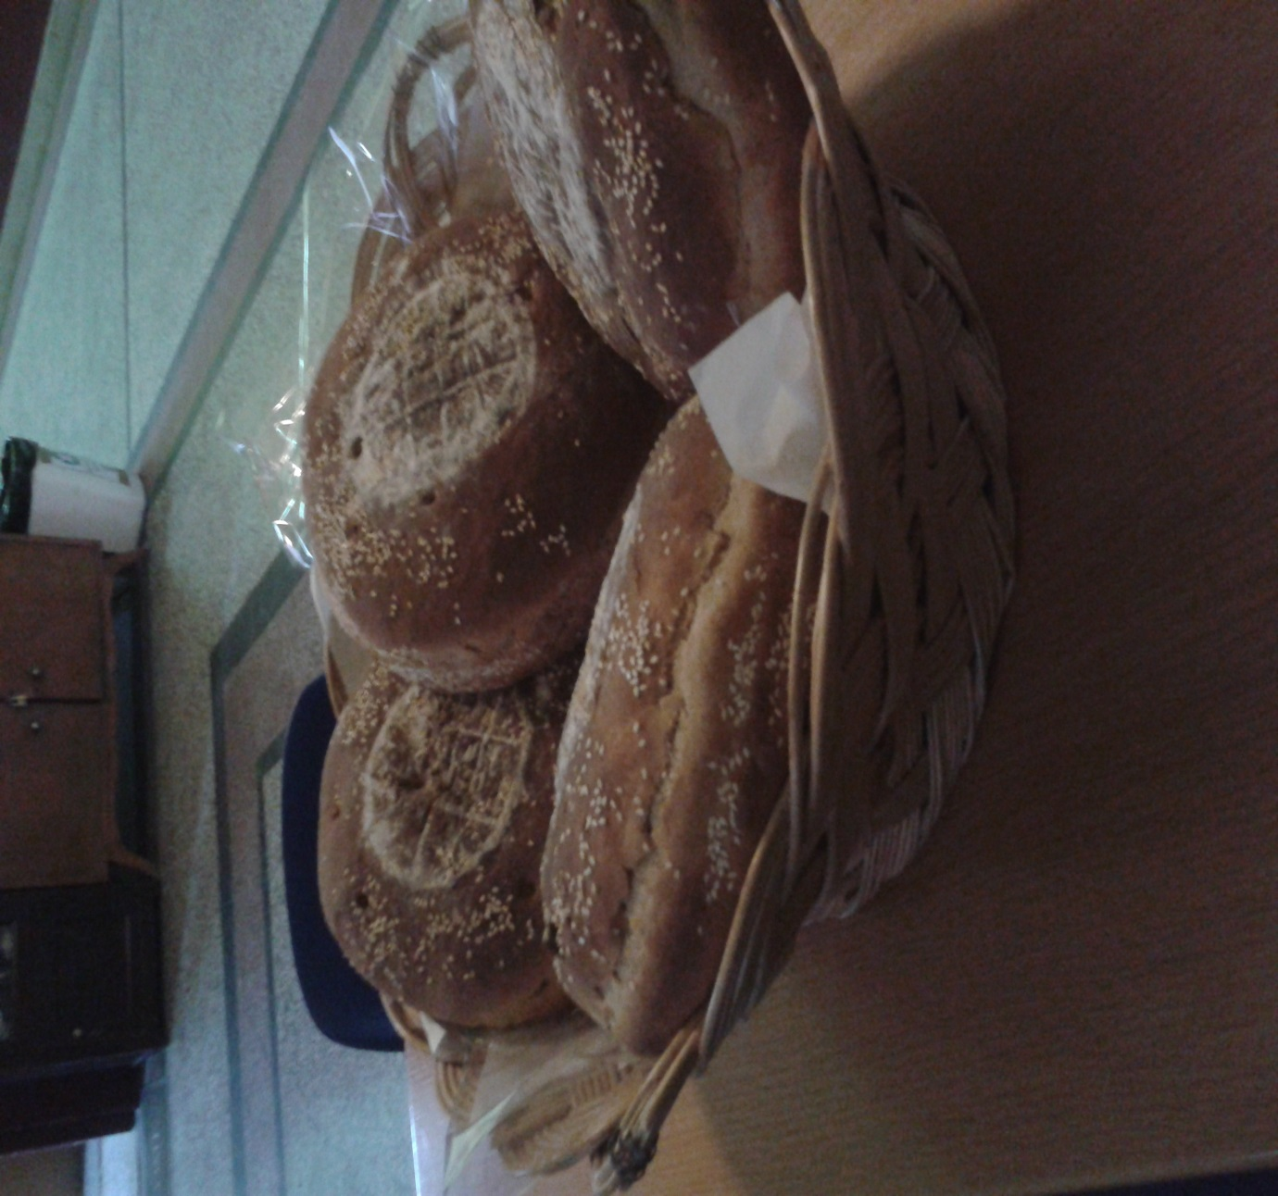
AFTER THAT AT SCHOOL WE CUT UP THE HOLY BREAD AND GIVE IT TO THE PUPILS.

Slide 10
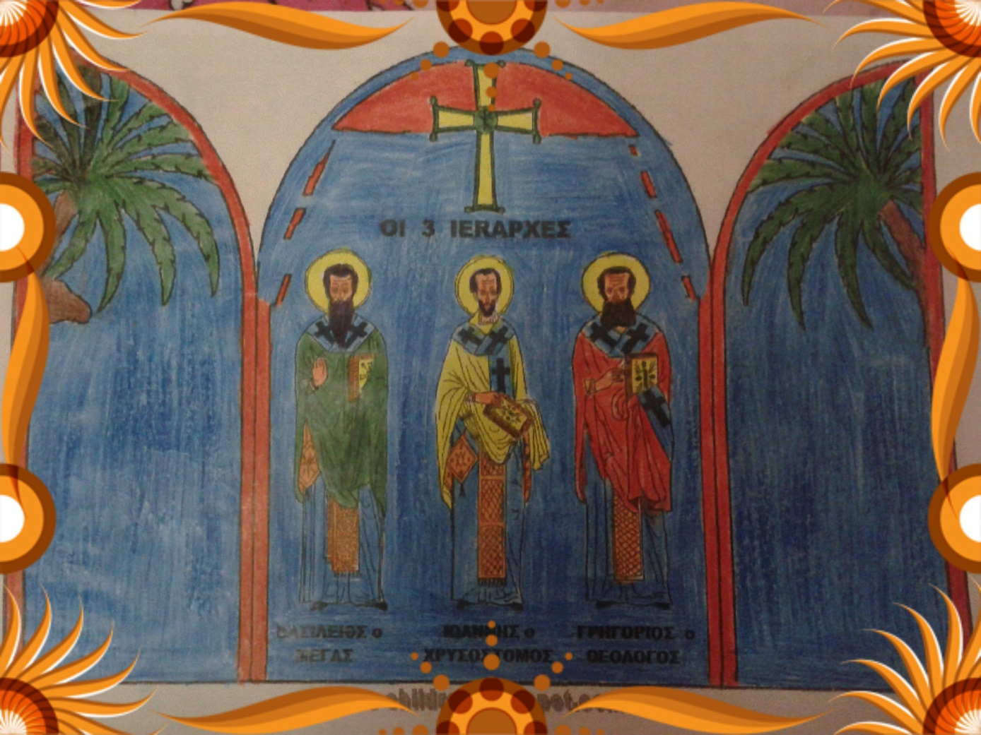
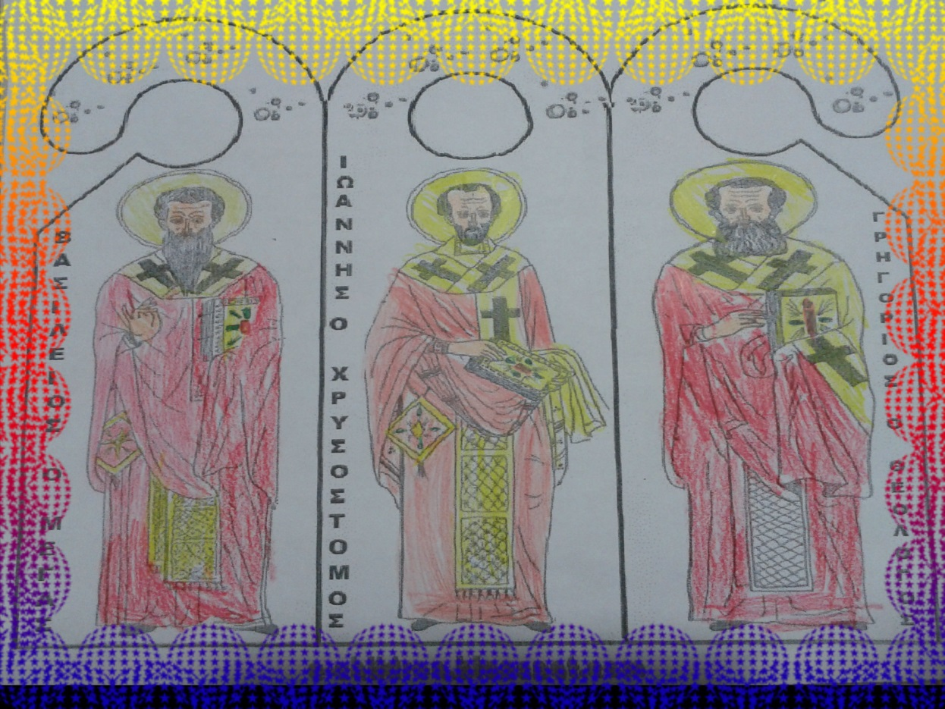
WE ALSO PAINT PICTURES OF THE 3 HIERARCHS

Slide 11
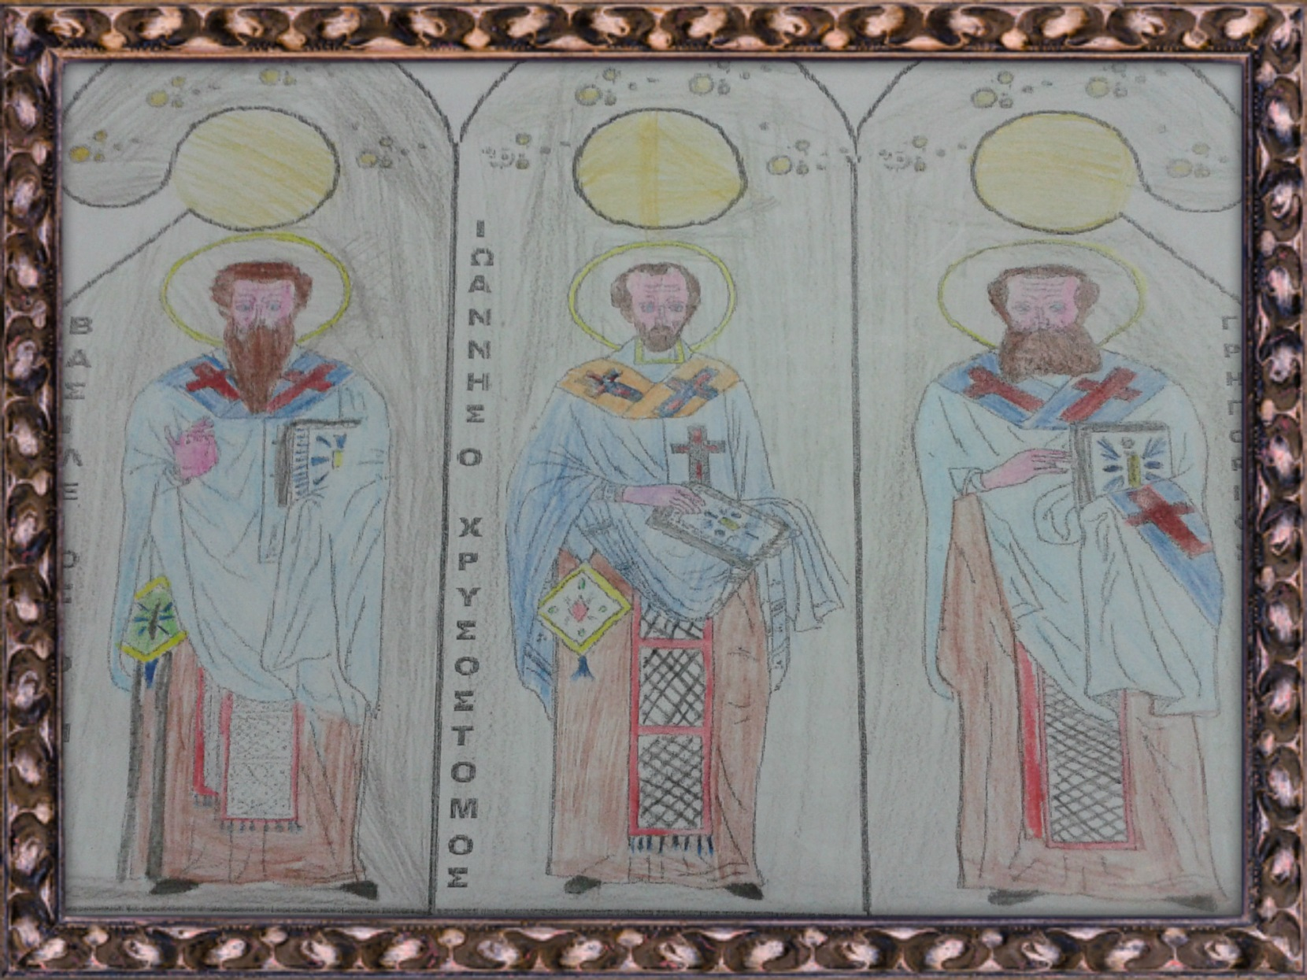
BY: MAYA AVAGIANOY AND ANASTASIA AVAGIANOY

