Slide 1
With the support of the Erasmus+ programme of the European Union and the Greek State Scholarships Foundation (I.K.Y.)
European Commission support for the production of this publication does not constitute an endorsement of the contents which reflects the views only of the authors, and the Commission cannot be held responsible for any use which may be made of the information contained therein

Slide 2
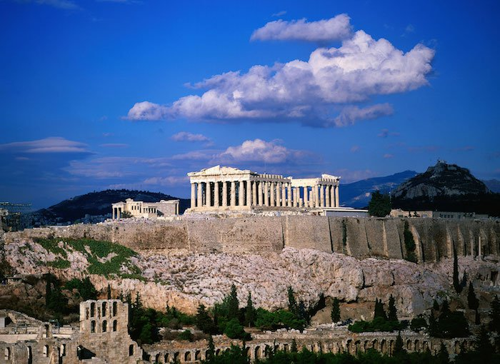
THE PARTHENON OF ATHENS
SOME HISTORY & A QUIZ
BY 6TH GRADE:
15 PUPILS
PAMFILA PRIMARY SCHOOL 2917-18
eTwinning project:
“FORGET ME NOT”

Slide 3
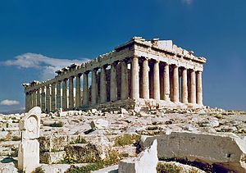
The Parthenon is a temple, on the Athenian Acropolis, Greece, dedicated to the goddess Athena, whom the people of Athens considered their patron. Construction began in 447 BC and was completed in 438 BC. It is the most important surviving building of Classical Greece, considered the zenith of the Doric order. The Parthenon was built under the general supervision of the artist Phidias, who also had charge of the sculptural decoration. The architects were Ictinos and Callicrates. Its decorative sculptures are considered some of the high points of Greek art. The Parthenon is regarded as a symbol of Ancient Greece, Athenian democracy, western civilization, and one of the world's greatest cultural monuments.

Slide 4
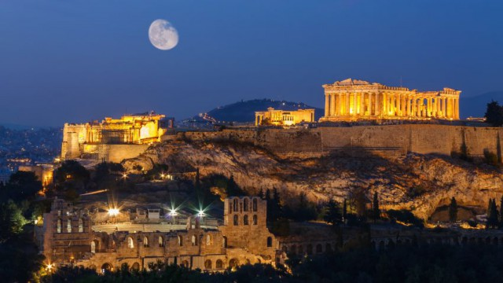
In the final decade of the 6th century AD, the Parthenon was converted into a Christian church dedicated to the Virgin Mary.After the Ottoman conquest, it was turned into a mosque in the early 1460s. On 26 September 1687, an Ottoman ammunition dump inside the building was ignited by Venetian bombardment. The resulting explosion severely damaged the Parthenon and its sculptures. From 1800 to 1803, Thomas Bruce, 7th Earl of Elgin removed 253 of the surviving sculptures with the alleged permission of the Ottoman Empire. These sculptures, now known as the Elgin Marbles or the Parthenon Marbles, were sold in 1816 to the British Museum in London, where they are now displayed. Since 1983 (on the initiative of Culture Minister Melina Mercouri), the Greek government has been committed to the return of the sculptures to Greece. https://en.wikipedia.org/wiki/Parthenon You can watch Gavras’ 7minute film on the history of the Parthenon through the centuries: https://www.youtube.com/watch?v=aGitmYl6U90

Slide 5
Originally a huge 35 foot statue of Athena overlaid in gold stood right at the center inside the building. The Athenians built the Parthenon to compensate for the tricks our eyes play. Each column has extremely slight variations throughout its many cylinders, sometimes with fractions of a millimeter the only thing distinguishing one block from another. But the cumulative effect compensates for our vision and always makes the columns appear perfectly straight.

Slide 6
1)When was the Parthenon built?
2)Who took the marbles of the Parthenon?
3)Where are the Parthenon marbles now?
a. 1800 AD
b.5th century BC
c. 8th century BC
a. Lord Byron
b. The Sultan
c. Lord Elgin
a. British Museum
b. Acropolis Museum
c. Louvre Museum

Slide 7
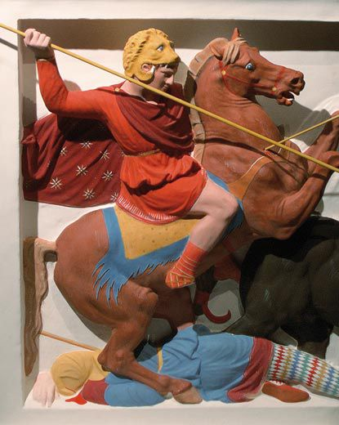
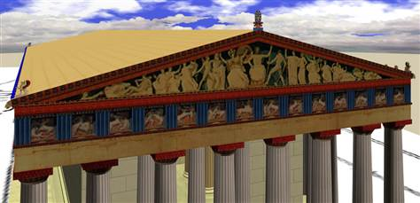
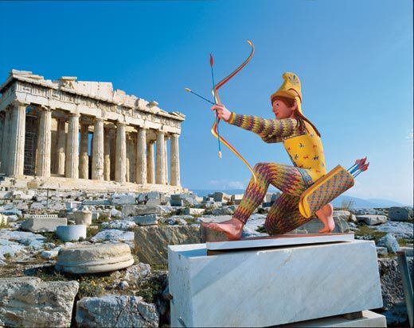
The surface of the sculpture was once covered in brilliant colors, but time has erased them.... Physical and chemical analyses, however, have helped German archaeologist Vinzenz Brinkmann establish the original colors with a high degree of confidence. He created full-scale plaster or marble copies hand-painted in the same mineral and organic pigments used by the ancients: green from malachite, blue from azurite, yellow and ocher from arsenic compounds, red from cinnabar, black from burned bone and vine.
https://www.smithsonianmag.com/arts-culture/true-colors-17888/

Slide 8
1)The Parthenon was completed in…
2)Elgin took ………… marbles.
3)The Parthenon is located in ………………..
a.1940 AD
b.500 BC
c. 432 BC
a. 253
b. 4000
c. 25
a. Crete
b. Thessaloniki
c. Athens

Slide 9
2)What was the Parthenon first used for?
a. church
b.temple
c.mosque
1)Which Goddess was the Parthenon dedicated to?
a. Athena
b. Hera
c. Aphrodite

Slide 10
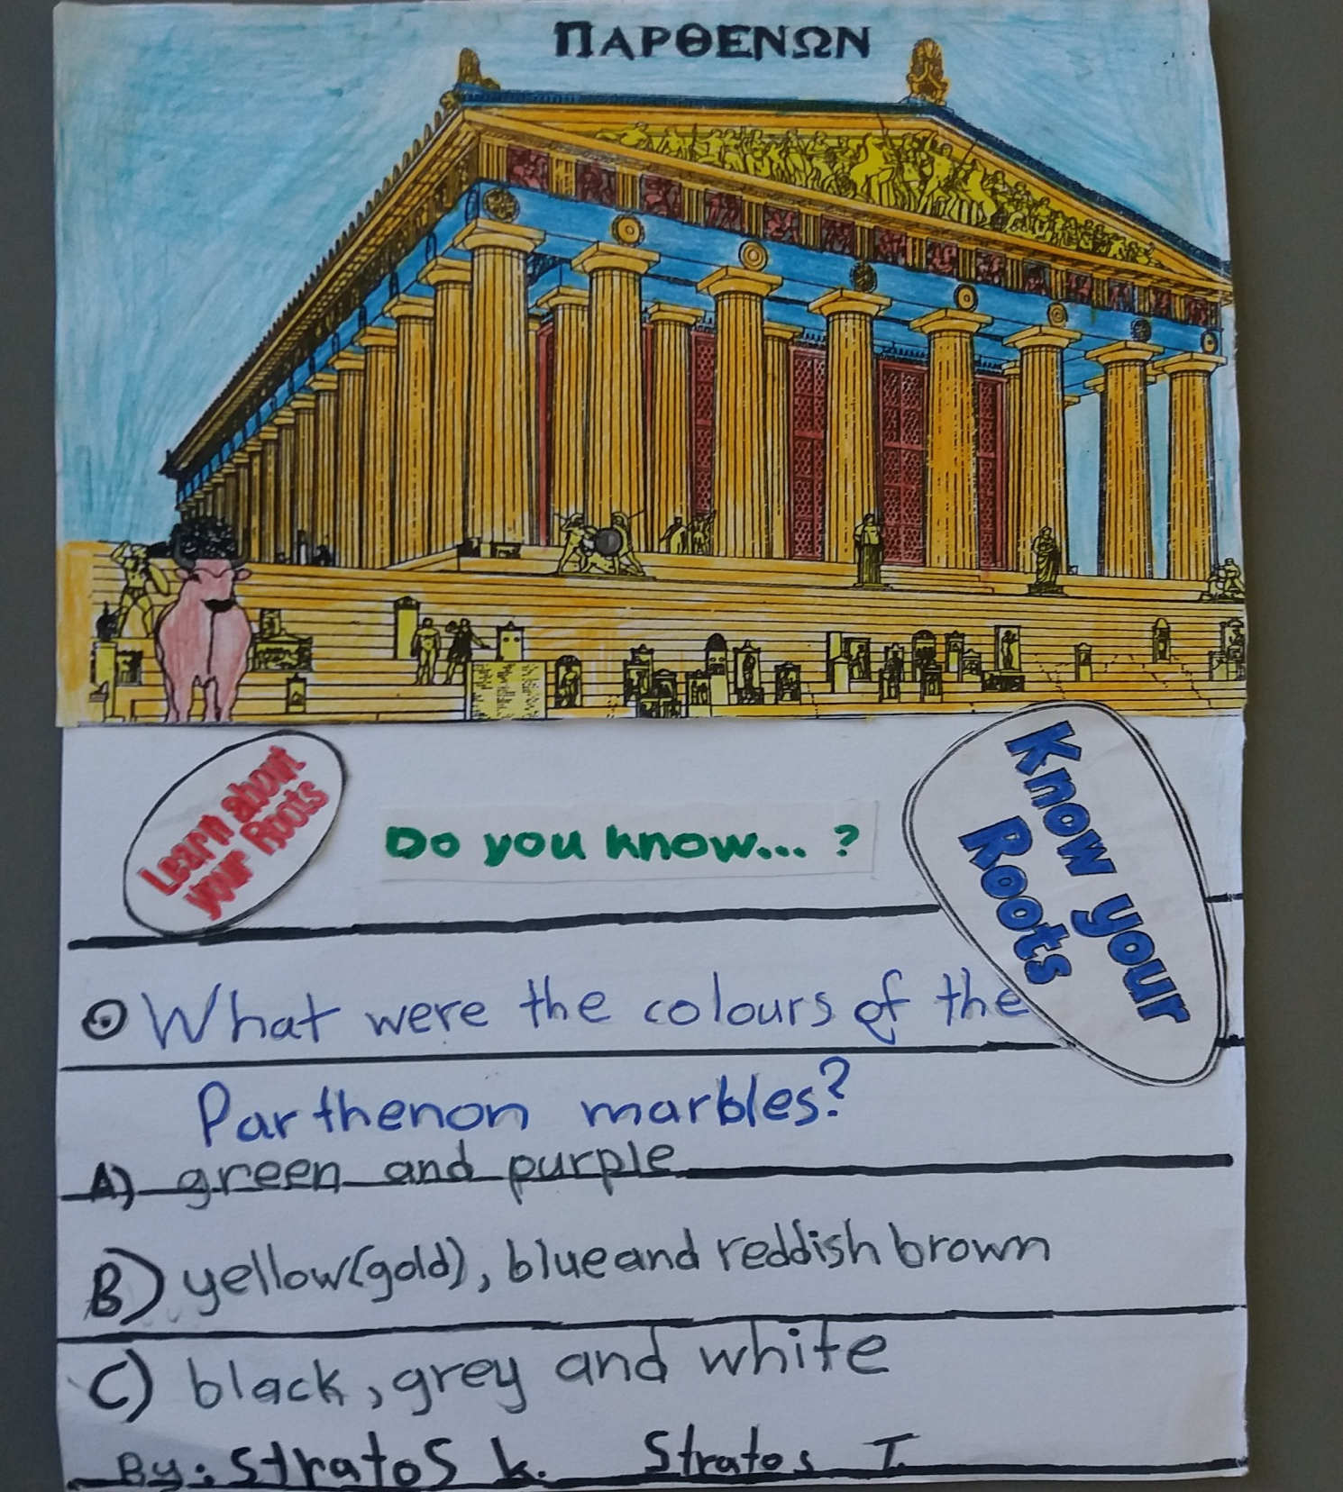
WELL DONE!
1)Who were the architects of the Parthenon?
2)What were the true colours of the Parthenon?
a. Aristotle and Plato
b. Ictinos and Callicrates
a. orange and purple
b. yellow, blue and red-brown
c. Elgin and Byron
c. grey and white

