Slide 1


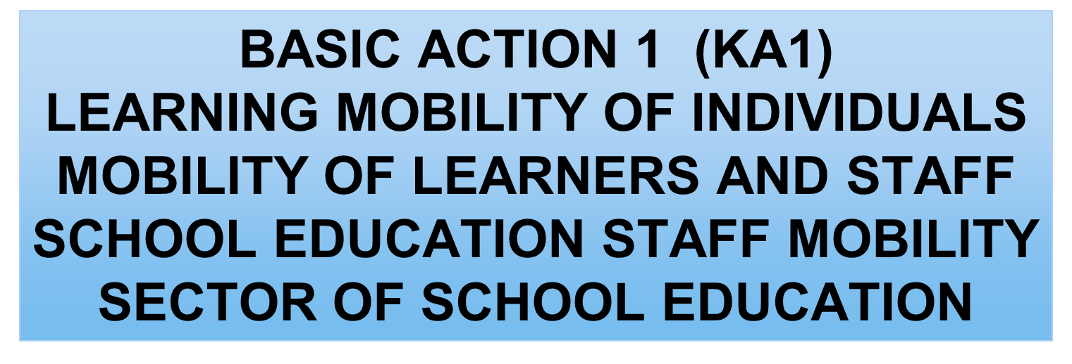

Slide 2
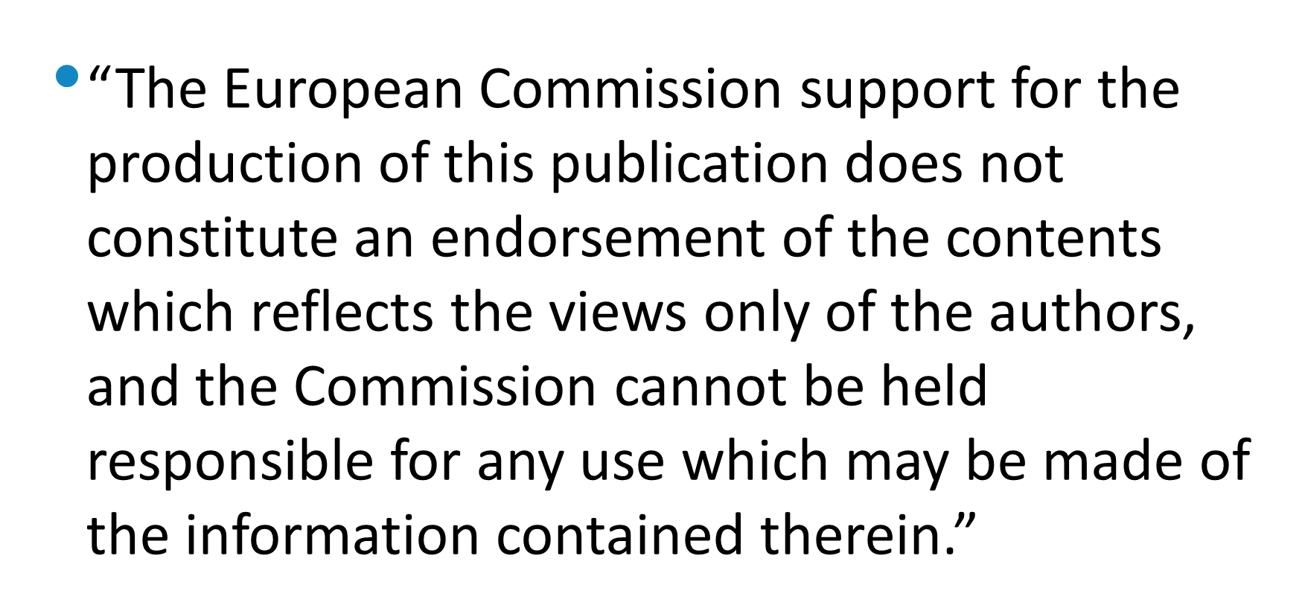

Slide 3
Primary School of Pamfila
“The School opens its door to Museums and Digital Technology”
Mobility Programme
«Reading the city: Tuscany»
3-9 September2017

Slide 4
OUR SCHOOL
PAMFILA PRIMARY SCHOOL
LESVOS ISLAND
GREECE/HELLAS

Slide 5
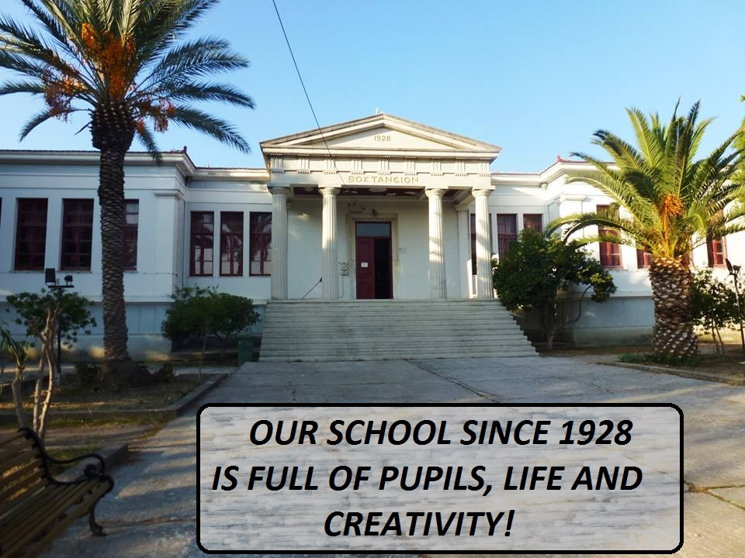

Slide 6
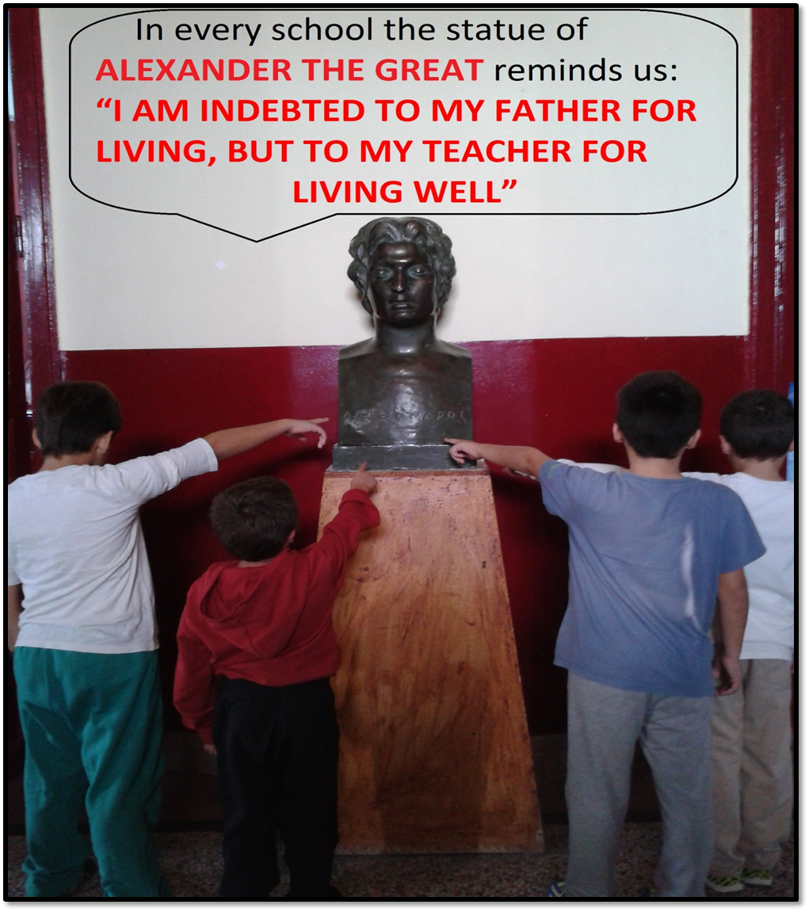
It was built in 1928 with Doric Order Columns in the façade and large windows. There are 6 large classrooms, a teachers’ office, a computer room and a theatrical stage in one of the classrooms. In the hall…

Slide 7
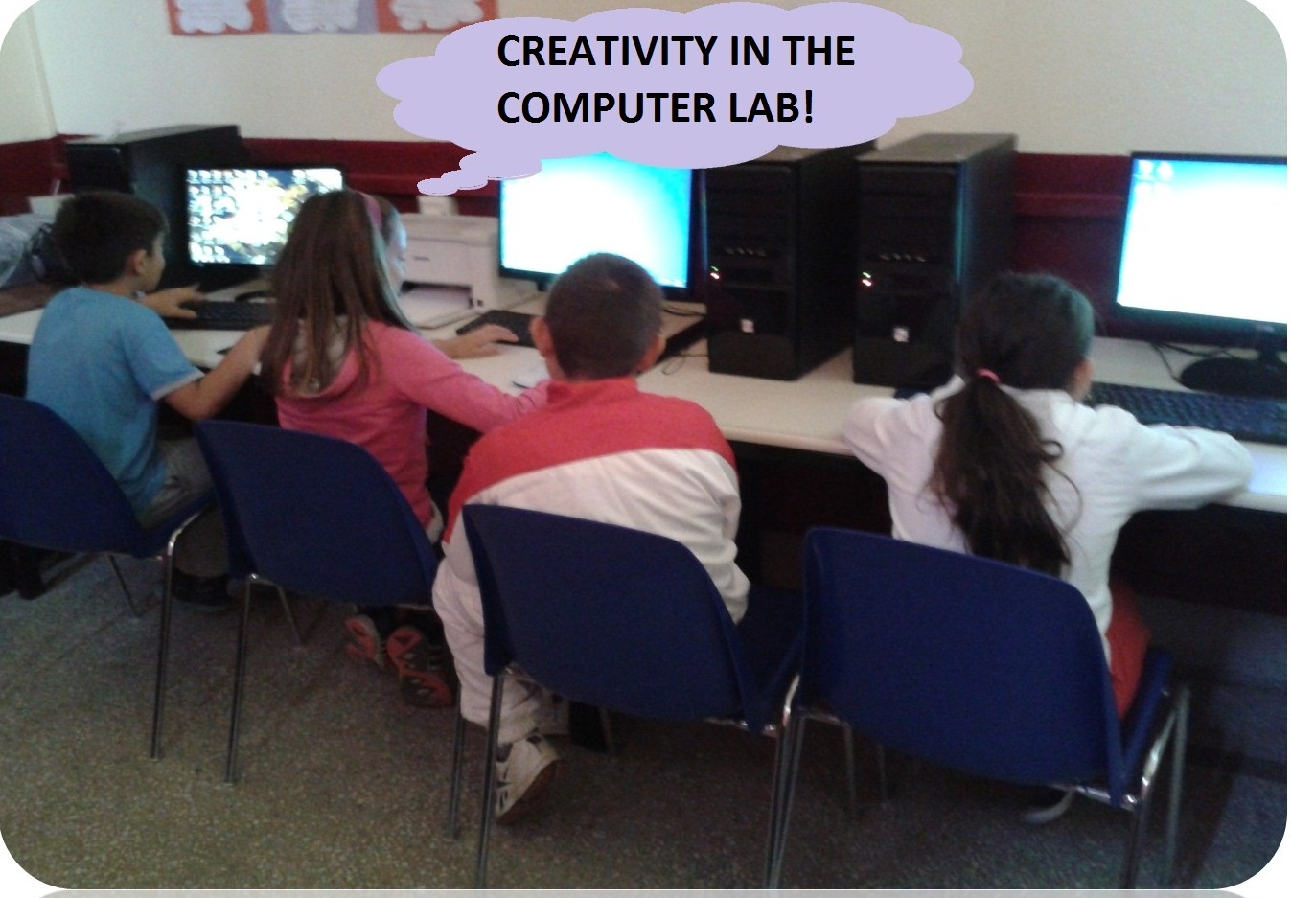

Slide 8
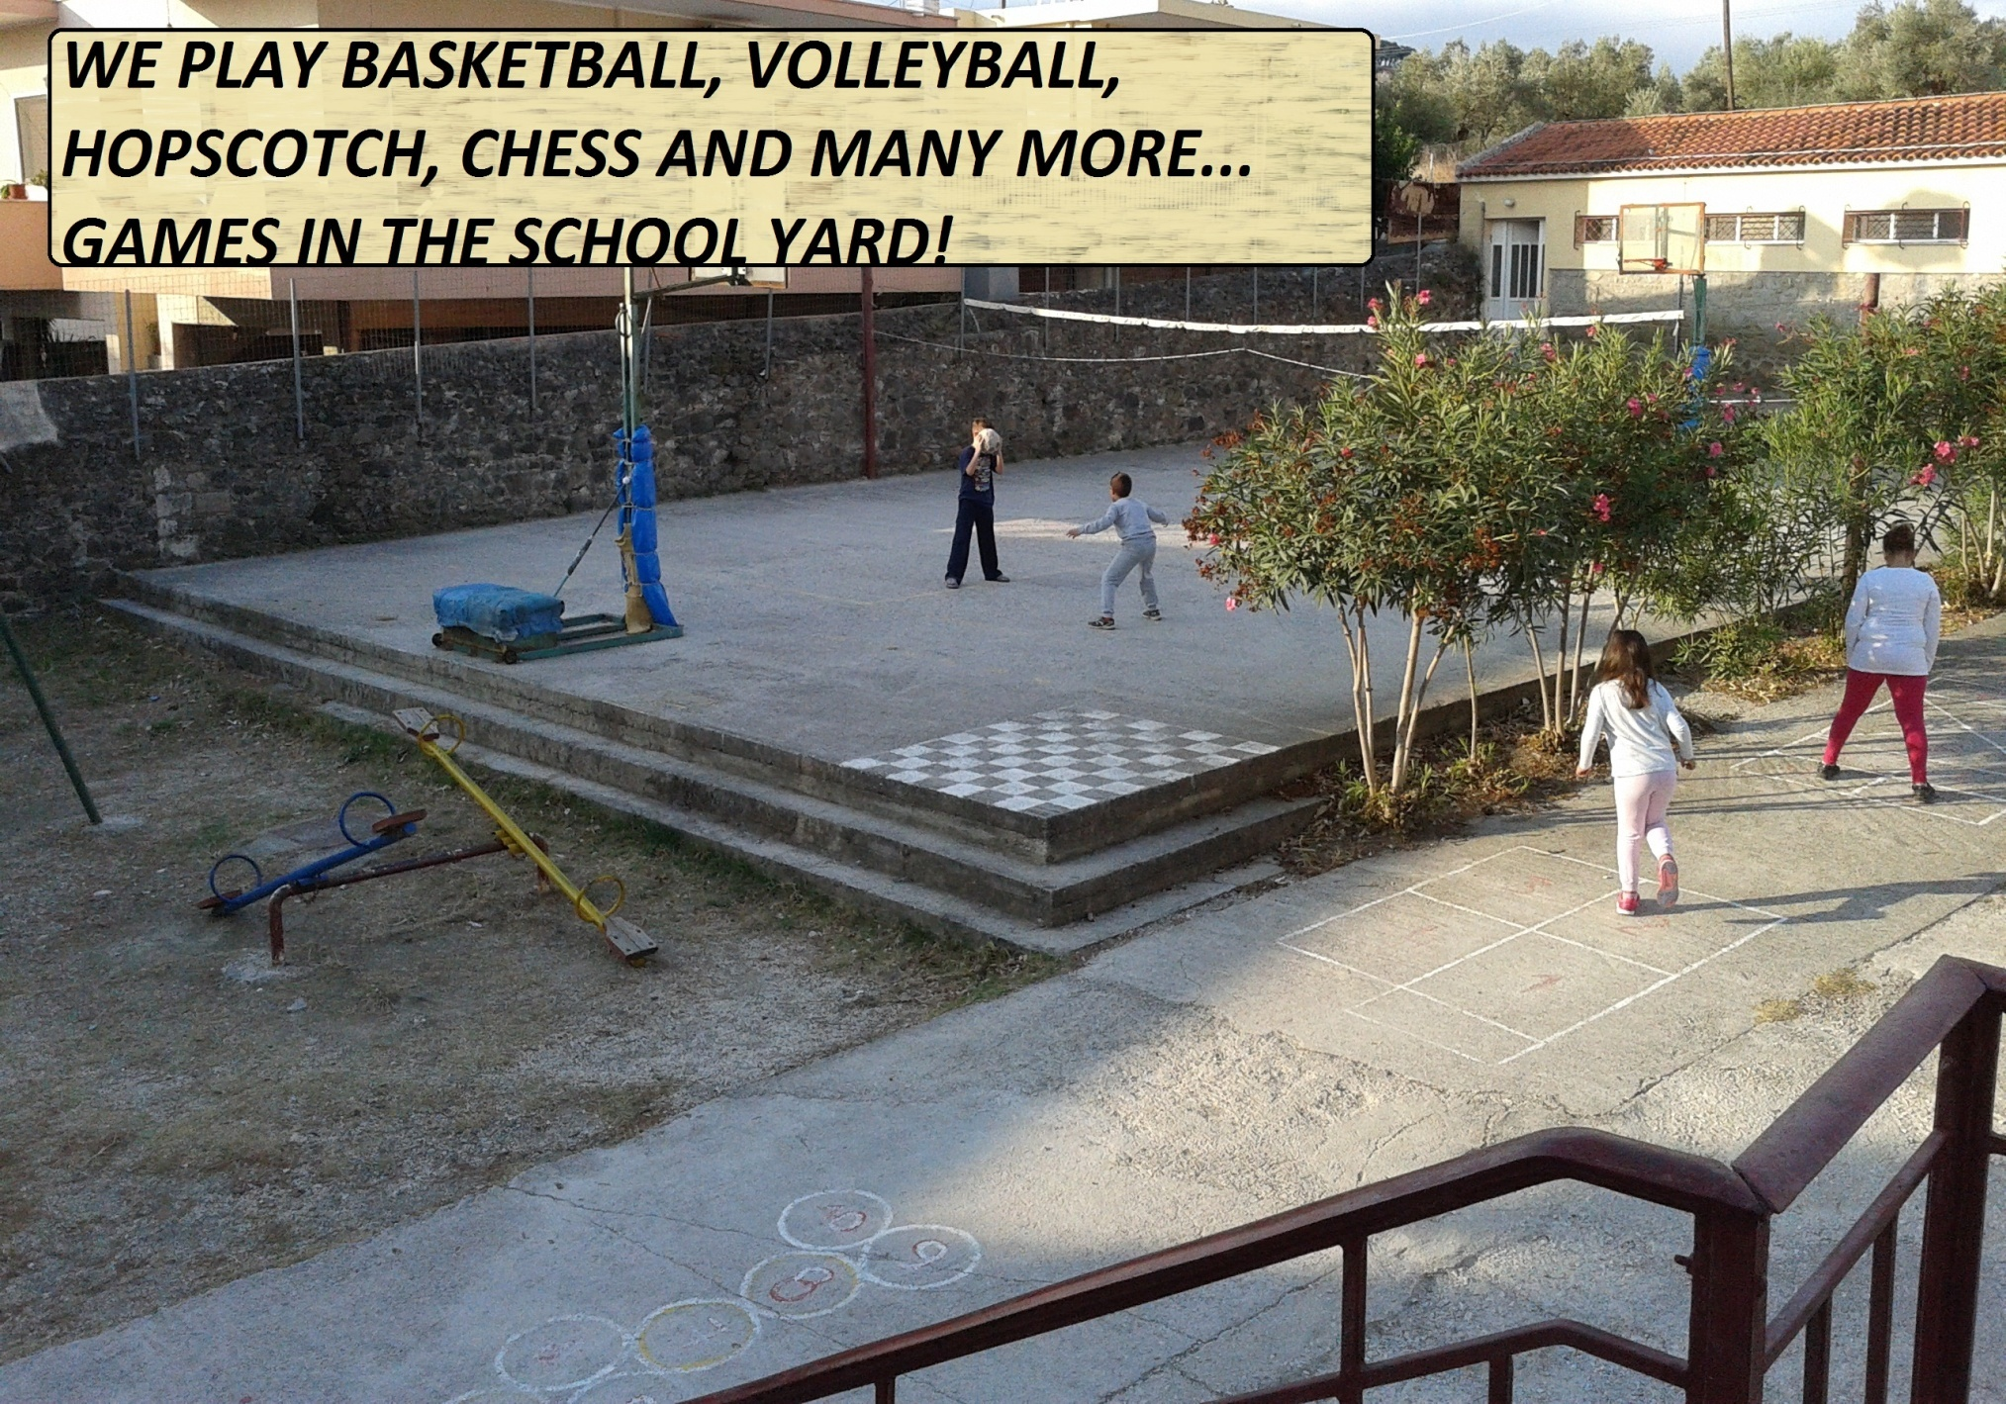

Slide 9
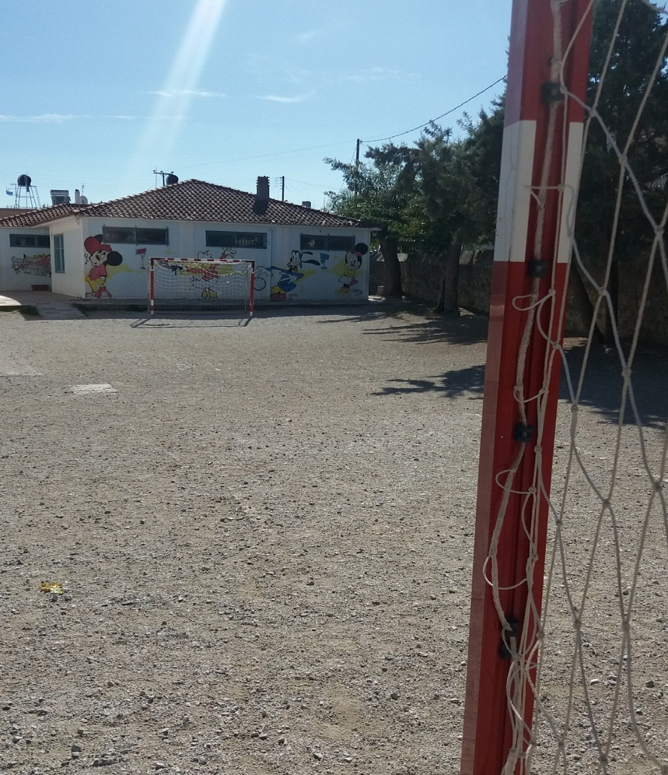
There is a football ground and a kindergarten in the back yard.

Slide 10
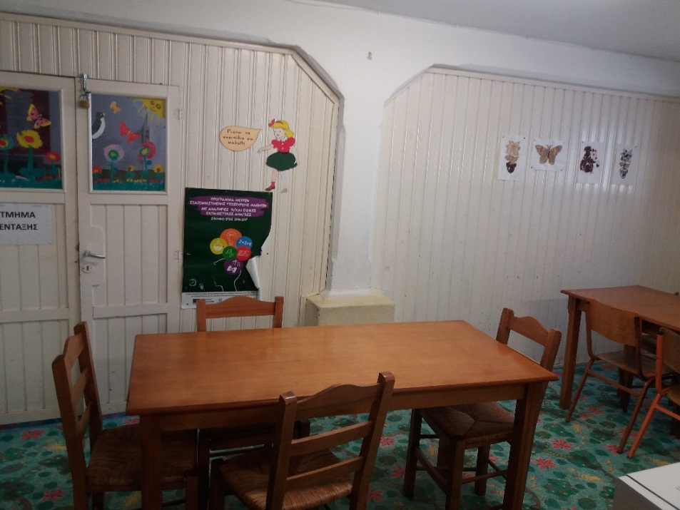
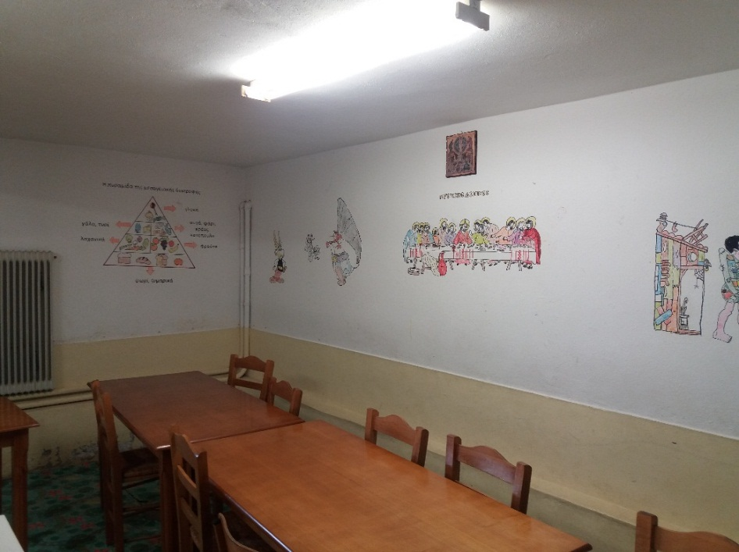
On the ground floor there is a dining room and a classroom for teaching children with learning disabilities.

Slide 11
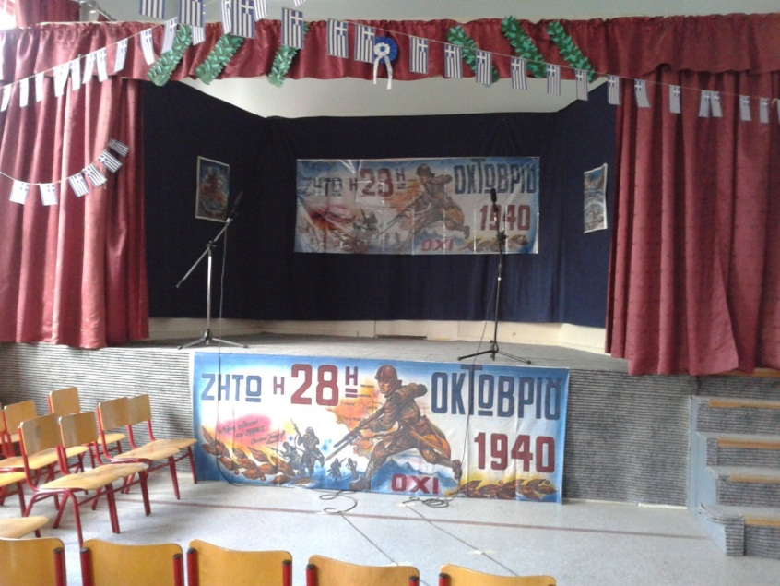
There are 14 teachers including the Head teacher, the P.E. teacher, English and French teacher, Music teacher, I.C.T. teacher, Arts teacher and the teacher for learning disabilities. There are about 100 to 110 pupils each year.

Slide 12
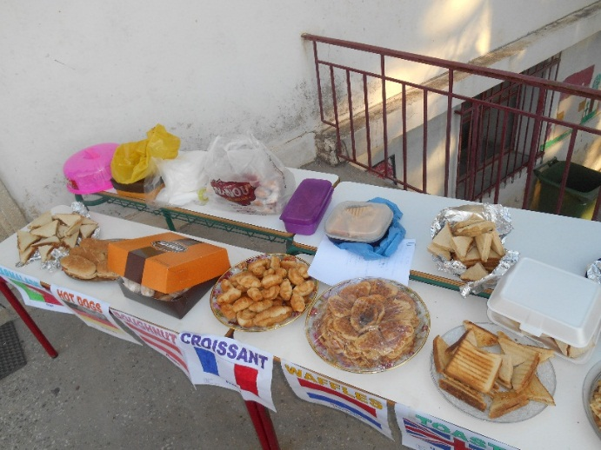
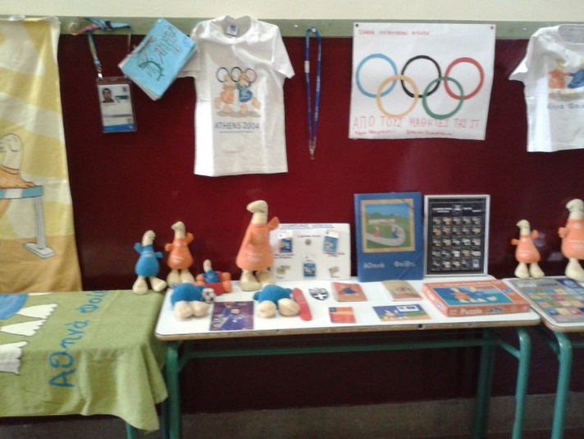
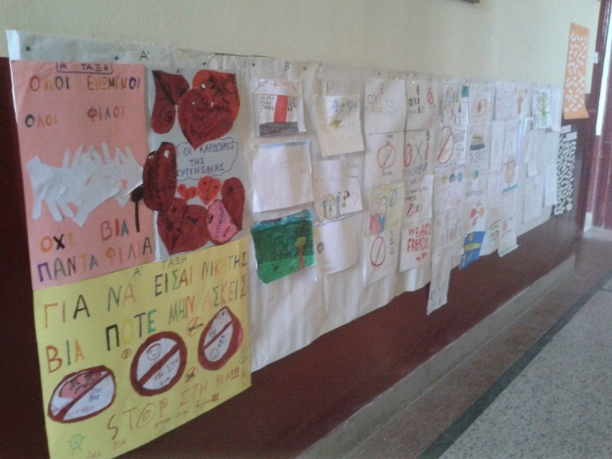
We take part in many activities: educational trips, Christmas celebration, school parades, Day of European Languages, Sports Day, Environmental Day, Anti-Bullying Day …, and we participate in etwinning projects (we have won 3 European quality Labels)!

Slide 13
Participants-teachers in the Erasmus+ programme,
“Reading The City”, 3-9 September 2017:
Chalkia Maria
Kefala Marina
Kleidaras George
Tsagkari Theodora

