Slide 1


BASIC ACTION 1 (KA1)
LEARNING MOBILITY OF INDIVIDUALS
MOBILITY OF LEARNERS AND STAFF
SCHOOL EDUCATION STAFF MOBILITY
SECTOR OF SCHOOL EDUCATION

Slide 2
“The European Commission support for the production of this publication does not constitute an endorsement of the contents which reflects the views only of the authors, and the Commission cannot be held responsible for any use which may be made of the information contained therein.”

Slide 3
Primary School of Pamfila
“The School opens its doors to Museums and Digital Technology”
Mobility Programme
«Reading the city: Tuscany»
3-9 September2017

Slide 4
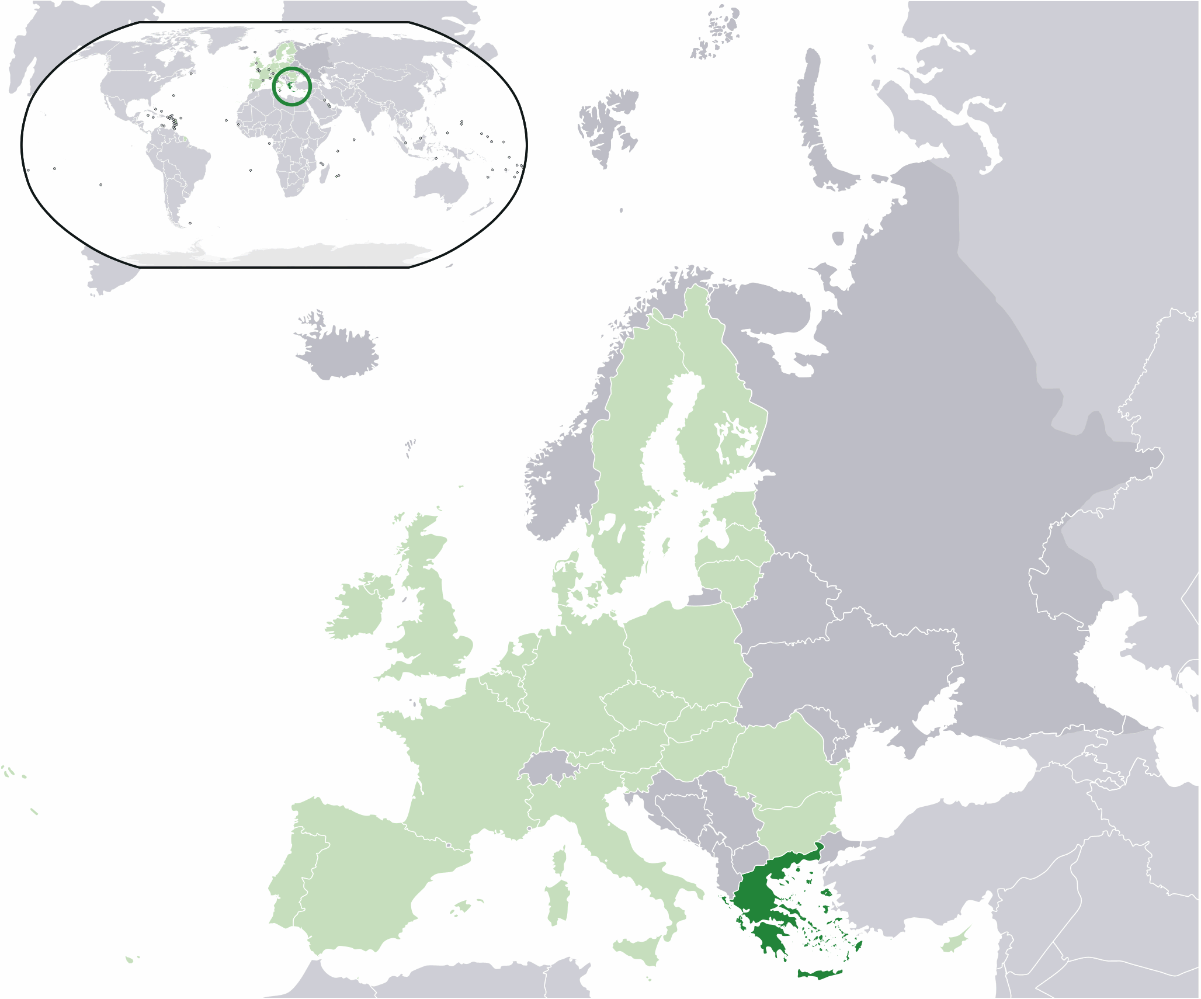
GREECE- HELLAS
Greece ( Ελλάδα), officially the Hellenic Republic , historically also known as Hellas,
is a country located in Southern Europe, with a population of approximately 11 million.
Athens is the nation's capital and largest city, followed by Thessaloniki.

Slide 5


The 9 bands of the flag correspond to the syllables of the Motto: «Ελευθερία ή Θάνατος»
Elefthería í Thánatos
"Freedom or Death" the blue and the white stand for the colours of the sea and sky.
The coat of arms
Of the Hellenic republic

Slide 6
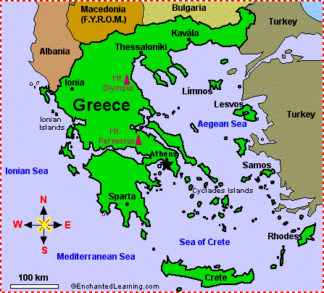
Geographic location
Greece/Hellas is located at the crossroads of Europe, Asia, and Africa. Situated on the southern tip of the Balkan Peninsula, it shares land borders with Albania to the northwest, the Republic of Macedonia and Bulgaria to the north, and Turkey to the northeast. The Aegean Sea lies to the east of the mainland, the Ionian Sea to the west, the Cretan Sea and the Mediterranean Sea to the south. Greece has the longest coastline on the Mediterranean Basin and the 11th longest coastline in the world and a large number of islands, of which 227 are inhabited.

Slide 7
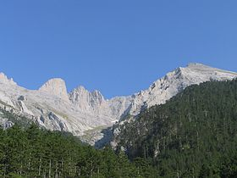
landform
Eighty percent of Greece is mountainous, with Mount Olympus being the highest peak at 2,918 m. The country consists of nine geographic regions: Macedonia, Central Greece, the Peloponnese, Thessaly, Epirus, the Aegean Islands (including the Dodecanese and Cyclades), Thrace, Crete, and the Ionian Islands.

Slide 8
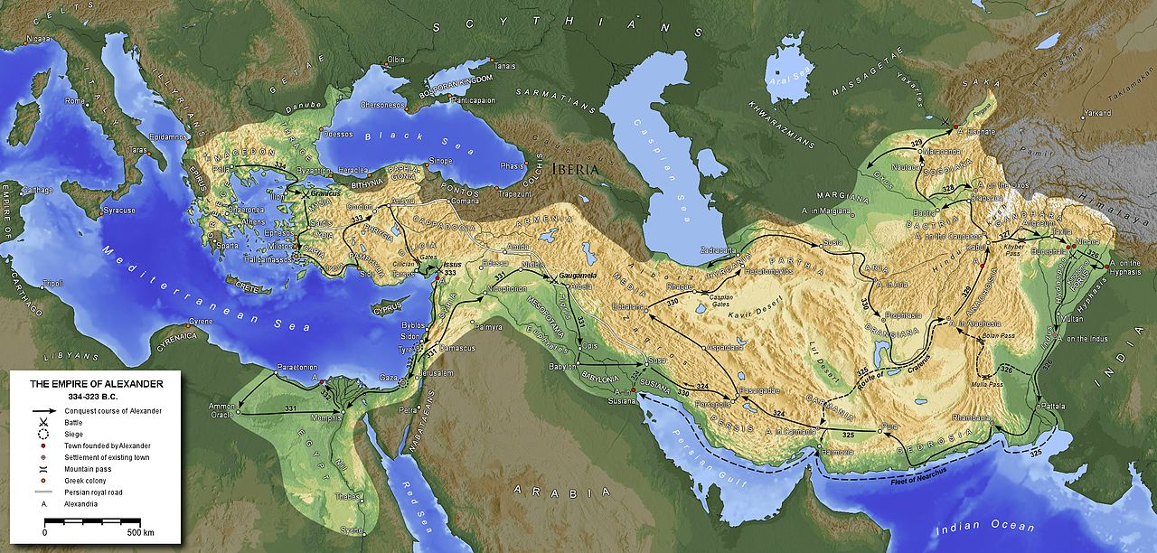
History and culture
Greece is considered the cradle of Western civilization, being the birthplace of democracy, Western philosophy, Western literature, historiography, political science, major scientific and mathematical principles, and Western drama, as well as the Olympic Games. Philip of Macedon united most of the Greek mainland in the fourth century BC, with his son Alexander the Great rapidly conquering much of the ancient world, spreading Greek culture and science from the eastern Mediterranean to India. Greece was annexed by Rome in the second century BC, becoming an integral part of the Roman Empire and its successor, the Byzantine Empire, wherein the Greek language and culture were dominant.

Slide 9
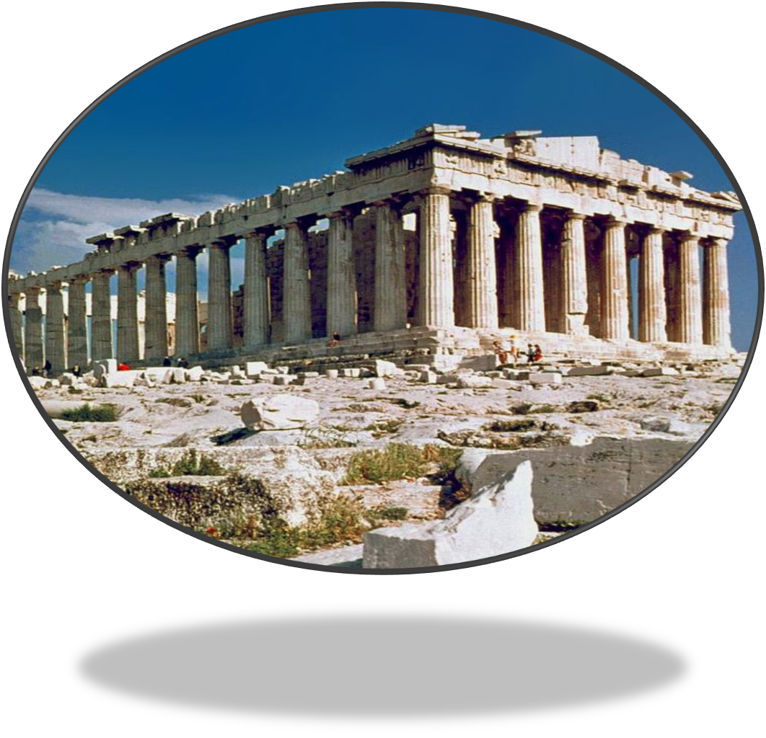
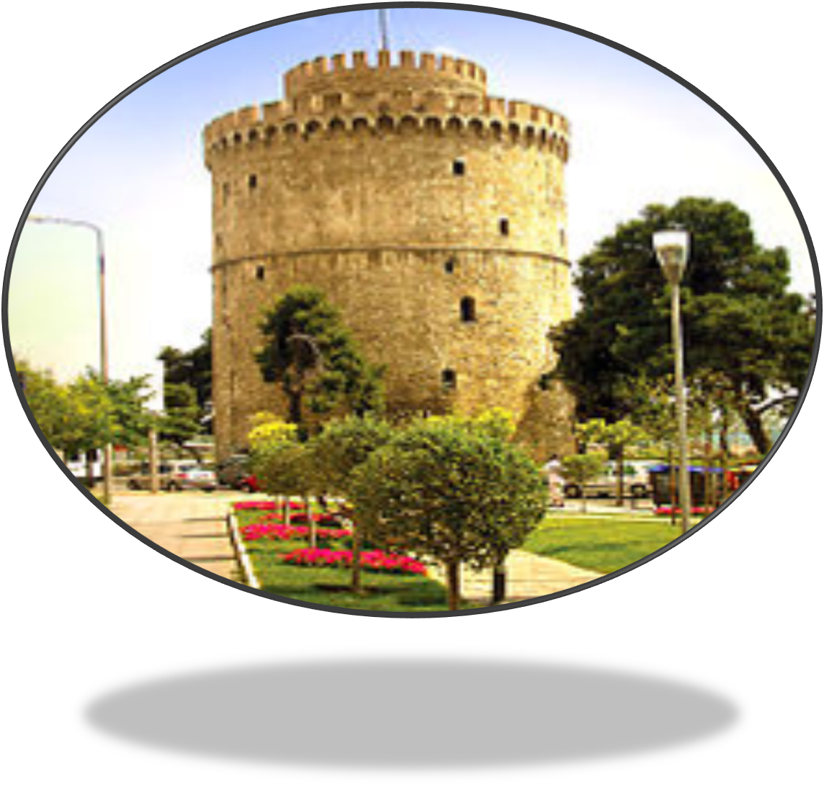
CULTURAL SIGHTS
THE PARTHENON
THE WHITE TOWER

Slide 10
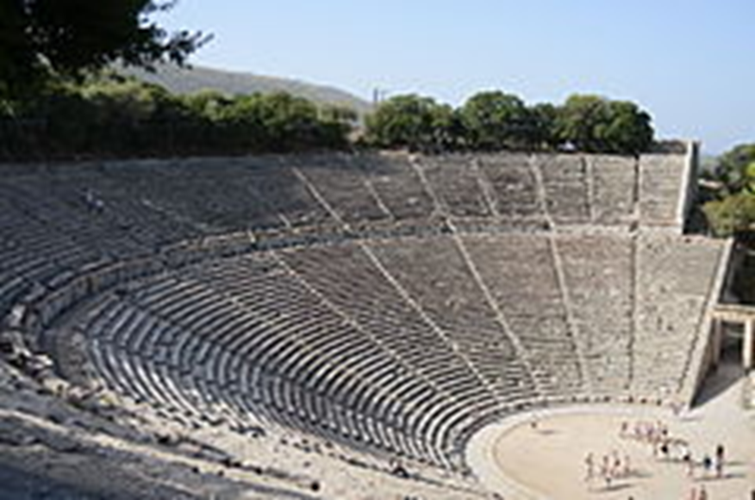
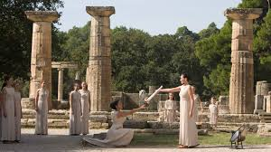
ANCIENT OLYMPIA
ANCIENT THEATRE OF EPIDAURUS

Slide 11
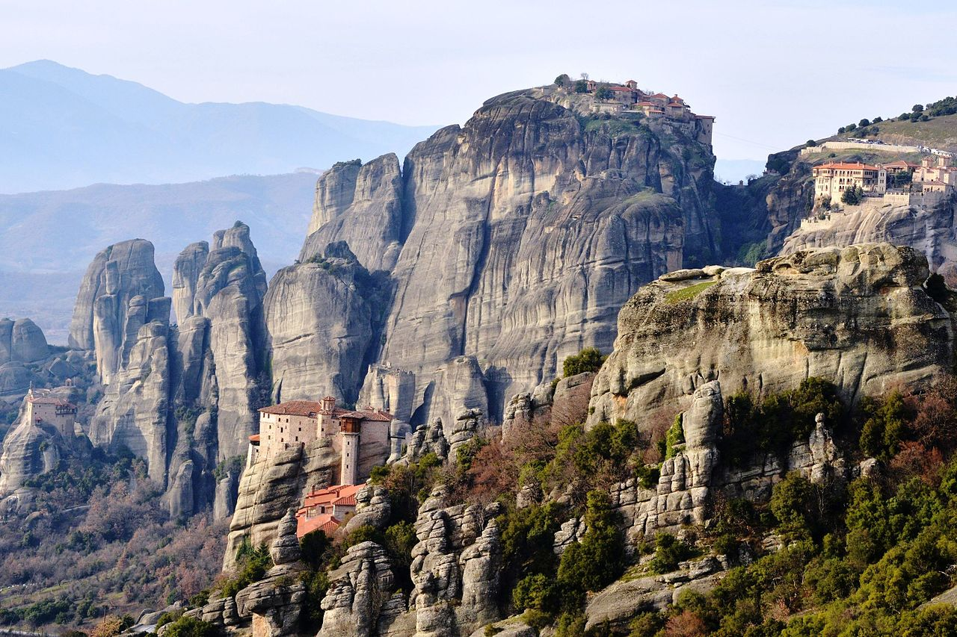
Religiosity in Greece (2015)
Eastern Orthodoxy (90%)
Other Christians (excluding Catholics) (3%)
Irreligion (4%)
Islam (2%)
Other religions (including Catholics) (1%)
RELIGION
The Greek Orthodox Church also shaped modern Greek identity and transmitted Greek traditions to the wider Orthodox World. Falling under Ottoman dominion in the mid-15th century, the modern nation state of Greece emerged in 1830 following a war of independence. Greece's rich historical legacy is reflected by its 18 UNESCO World Heritage Sites, among the most in Europe and the world.

Slide 12
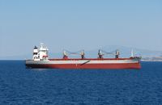
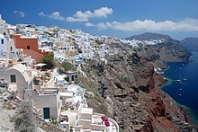
economy
Greece is a democratic and developed country with an advanced high-income economy, a high quality of life, and a very high standard of living. A founding member of the United Nations, Greece was the tenth member to join the European Communities and has been part of the Eurozone since 2001. It is also a member of numerous other international institutions, including the Council of Europe, the North Atlantic Treaty Organization (NATO). Greece's unique cultural heritage, large tourism industry, prominent shipping sector and geostrategic importance classify it as a middle power. It is the largest economy in the Balkans, where it is an important regional investor.
Greece controls 16.2% of the world's total merchant fleet,

Slide 13
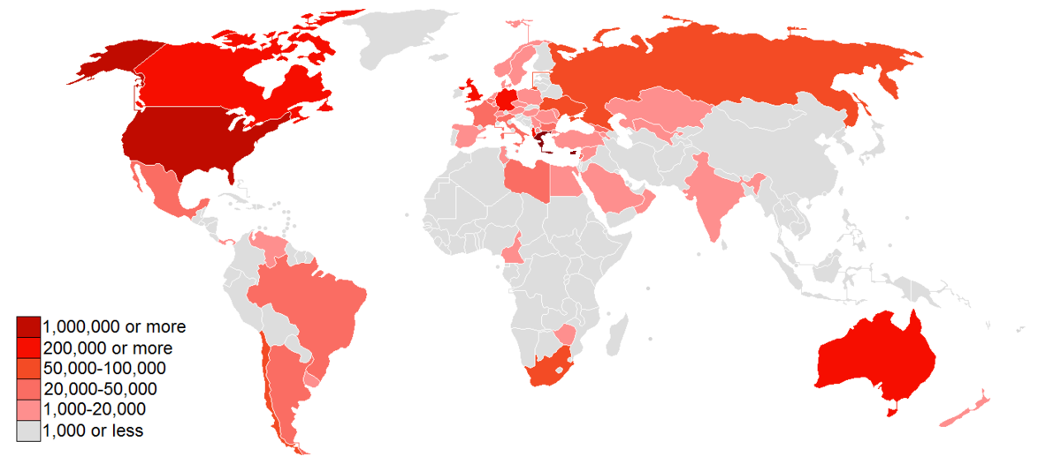
Throughout the 20th century, millions of Greeks migrated to the United States, United Kingdom, Australia, Canada, and Germany, creating a large Greek diaspora. Net migration started to show positive numbers from the 1970s, but until the beginning of the 1990s, the main influx was that of returning Greek migrants or of Pontic Greeks and others from Russia, Georgia, Turkey the Czech Republic, and elsewhere in the former Soviet Bloc
MIGRATION

Slide 14
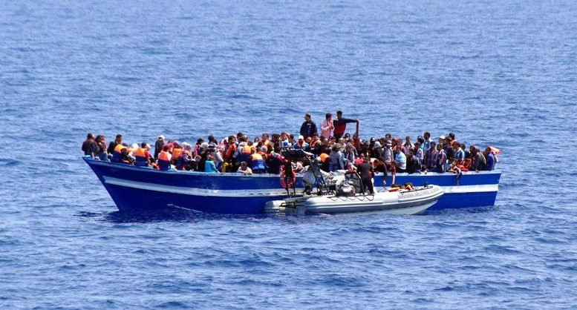
IMMIGRATION
Greece, together with Italy and Spain, is a major entry point for illegal immigrants trying to enter the EU. Illegal immigrants entering Greece mostly do so from the border with Turkey at the Evros River and the islands of the eastern Aegean across from Turkey (mainly Lesbos, Chios, Kos, and Samos). In 2012, the majority of illegal immigrants entering Greece came from Afghanistan, followed by Pakistanis and Bangladeshis. In 2015, arrivals of refugees by sea had increased dramatically mainly due to the ongoing Syrian civil war. There were 856,723 arrivals by sea in Greece.

Slide 15
SOURCEs: Wikipedia
Participants-teachers in the Erasmus+ programme,
“Reading The City”, 3-9 September 2017:
Chalkia Maria
Kefala Marina
Kleidaras George
Tsagkari Theodora

