Slide 1
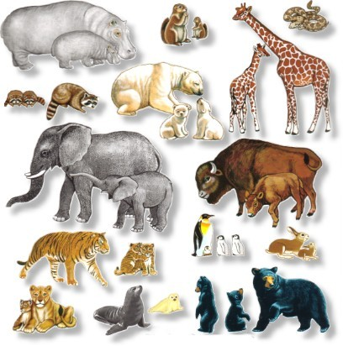
WILD
ANIMALS
IN THE ZOO,
FOREST,
DESERT,
SAVANNAH,
OCEAN,
JUNGLE,
ARCTIC,
SWAMP(=ΒΑΛΤΟΣ)…

Slide 2
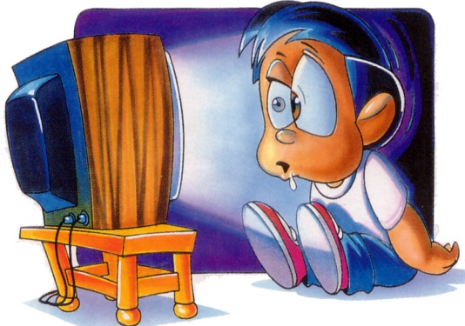
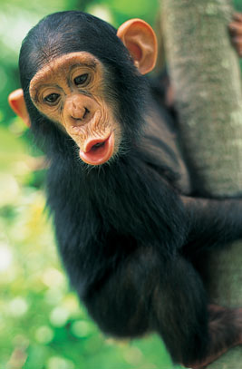
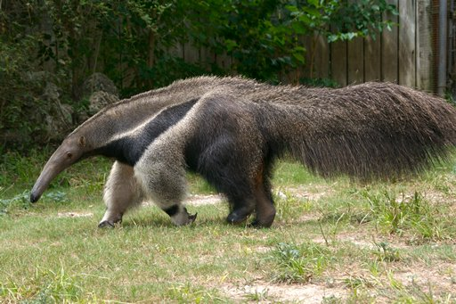
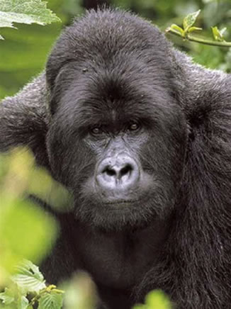
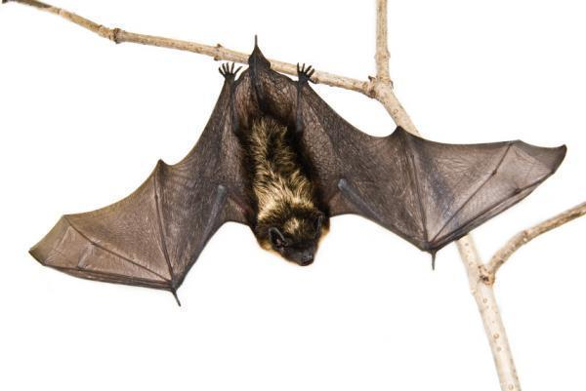
We are going to watch videos!
Watch the video and write down how many animals you see. Click on.→ JUNGLE
  Do you know all the animals? Say their names.
Chimpanzee
Anteater
Bat
Gorilla

Slide 3

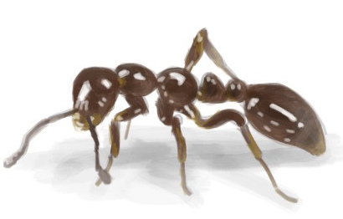
Ant + eater = …
?

Slide 4
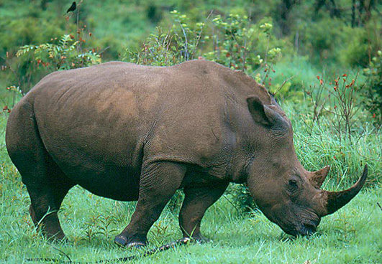
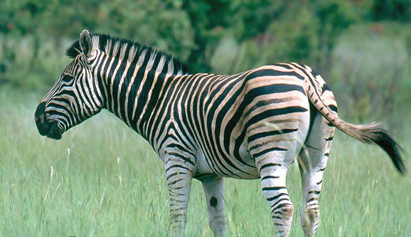
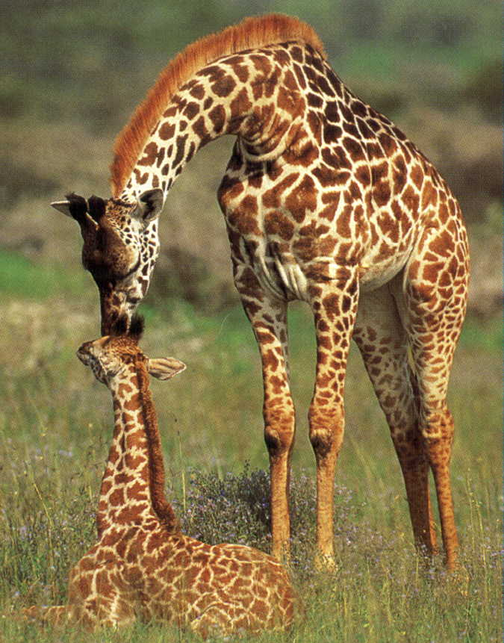
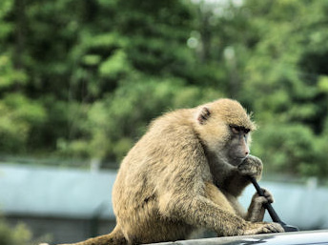
Another one?
Now watch the next video. SAFARI
Say the names of the animals.
Zebra
Rhinoceros
Giraffe
Monkey

Slide 5
Fill in the gaps with “be going to” or “will/won’t”
Help Nature!
My family and I want to help nature in our own homes. This weekend, we ________ (build) a birdhouse in the corner of our garden. We ______ (plant) wild flowers there. But first, I ________ (walk) to the forest near our house and I______ (collect) some wild plants.
Oh, I hope I _____ (not meet) bears tomorrow! It ____ (be) scary to go there alone! But I am brave. I think I _______(manage) to help nature.
are going to build
are going to plant
am going to walk
am going to collect
won’t meet
will be
will manage
Notes:
Fill in the first paragraph with “be going to”
Fill in the second paragraph with “will”

Slide 6

Are you an Animal Expert?
What does an anteater eat?
a) Squirrels b) Ants c) Leaves d) Coconut
What is the fastest animal in the world?
a) Zebra b) Wolf c) Kangaroo d) Cheetah
How many spines has a hedgehog?
a) one hundred b) one million c) more than five thousand d) one thousand
Where do penguins live?
a) In the Mediterranean b) in Canada c) at the Sounth Pole d) in the zoo

Slide 7
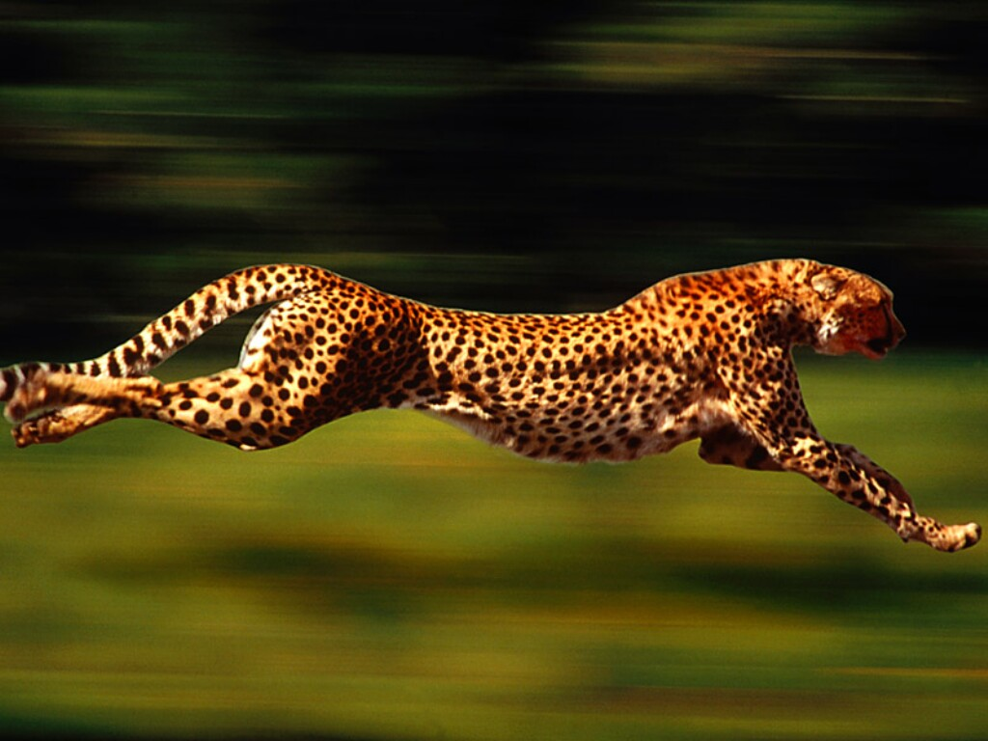
Notes:
Cheetah

Slide 8
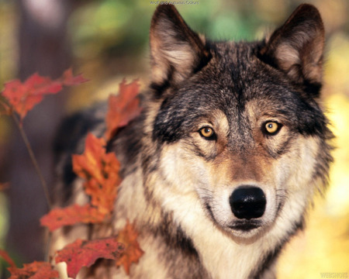
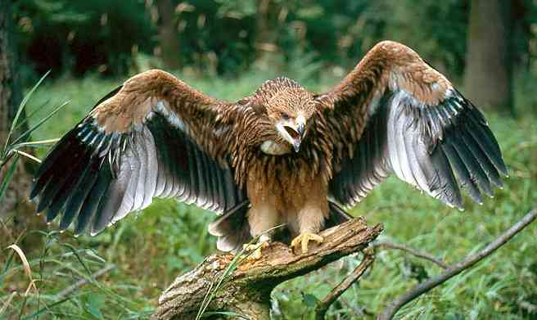
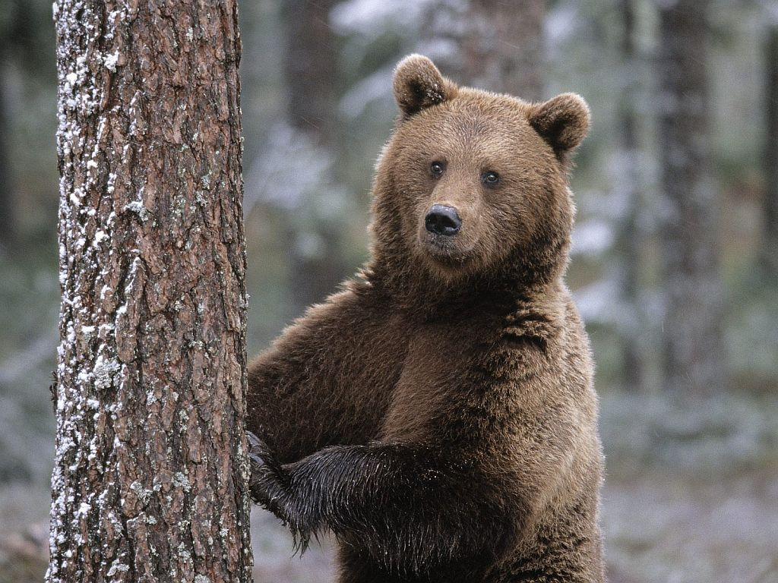
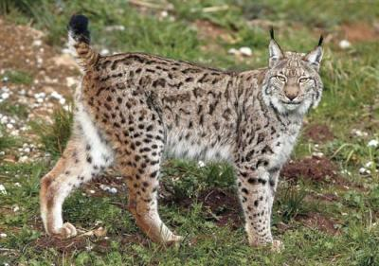
Endangered Animals
EAGLE
WOLF
LYNX
BEAR
Notes:
Can you name any of these endangered animals in the picures?
Where do you think they live? (Accept answers: forest, woods, mountains…) Spanish Imperial Eagle = Extremadura; Iberian Wolf = Castilla y Leon, Galicia, Asturias; Cantabrian brown bear = West Asturias, Leon, Lugo, Cantabria; Iberian Lynx = Andalucia.
Why do you think they are in danger of extinction?
What can be done to save them?
Hunted by man.
Deforestation.
Pollution of water.

Slide 9
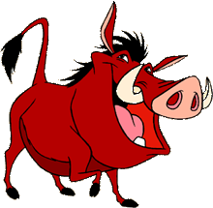
Keep up the good work!
"Hakuna Matata“-
“There are no problems!"

