Slide 1
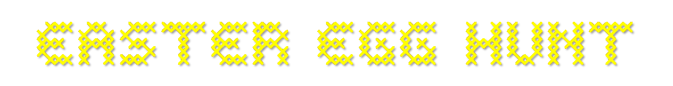

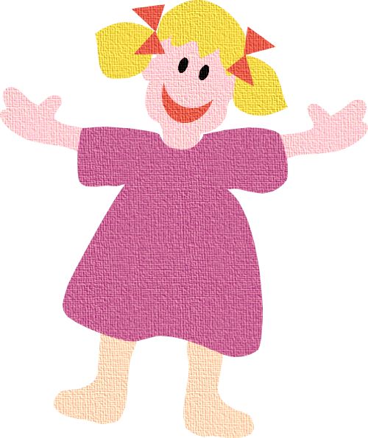
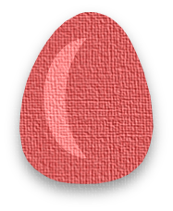



Easter egg hunt is common all over the world. Eggs are hidden by adults and children hunt and collect them.
The one with the most eggs is the winner.
Can you help me to hunt the colored eggs, please?

Slide 2


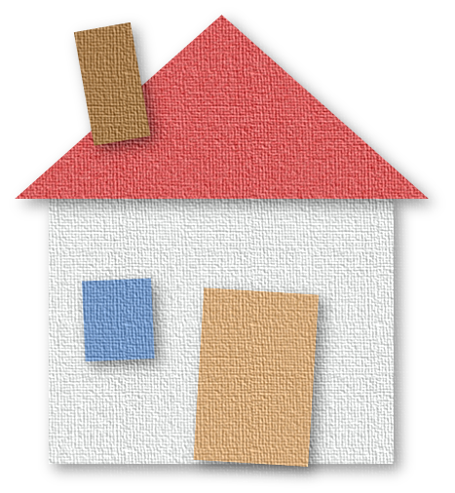
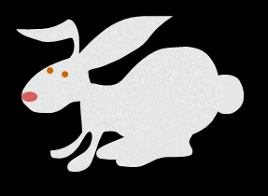
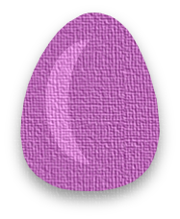

Hunt the egg under the bunny

Slide 3
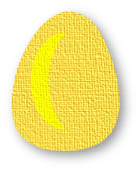


Hunt the egg behind the bunny

Slide 4
Hunt the egg in front of the house

Slide 5

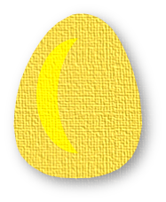






in
The red egg is ____________ the pond
between
behind
on
in

Slide 6

on
The purple egg is ____________ the cloud
between
behind
on
under

Slide 7
next to
The blue egg is ____________ the tree
between
next to
on
in

Slide 8
between
The yellow egg is ____________ the flowers
between
behind
around
under

Slide 9


THANKS and HAPPY EASTER!
EXIT

