Slide 1


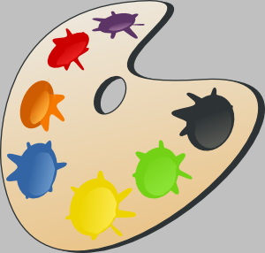

Slide 2

black

Slide 3

brown

Slide 4

red

Slide 5

orange

Slide 6

yellow

Slide 7

green

Slide 8

blue

Slide 9

grey

Slide 10

pink

Slide 11

purple

Slide 12

white

