Slide 1
BASIC ACTION 1 (KA1)
LEARNING MOBILITY OF INDIVIDUALS
MOBILITY OF LEARNERS AND STAFF
SCHOOL EDUCATION STAFF MOBILITY
SECTOR OF SCHOOL EDUCATION

Slide 2
“The European Commission support for the production of this publication does not constitute an endorsement of the contents which reflects the views only of the authors, and the Commission cannot be held responsible for any use which may be made of the information contained therein.”

Slide 3
Primary School of Pamfila “The School opens its doors to Museums and Digital Technology”
Mobility Programme
«Reading the city: Tuscany»
3-9 September2017

Slide 4
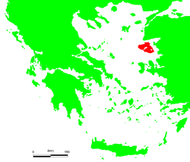
LEsvos
Lesvos is the 3rd largest island in the northeast Aegean Sea with about 86.000 people across from Turkey. There are 2 big gulfs, Kalloni’s and Gera’s. Its capital is Mytilene with about 28.000 people. There is the Aegean University and the Ministry of the Aegean.

Slide 5
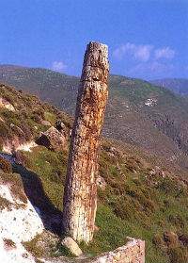
Petrified forest
In 2012 the whole island became part of the UNESCO World Geopark Net. The unique Petrified Forest in Sigri is the most important monument of the Geopark with 20 million-year-old trees made from the covering of volcanic ash.

Slide 6
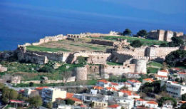
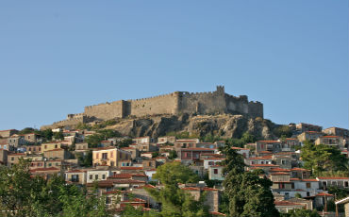
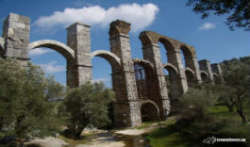
Medieval Castles of Mytilene and mithimna roman aqueduct in moria

Slide 7
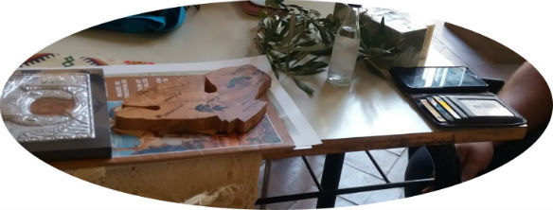
ITEMS we bring to the seminar to present our homeland
Our island is famous for its olive oil, olive oil soap, sardines, cheese products and ouzo drink. It is also well known for the wood carvings, pottery, embroidery and monasteries.

Slide 8
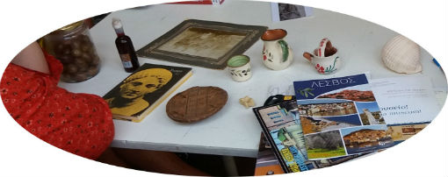
We also bring olives, a sea shell, a map, old things and historic photos, museum brochures and Sappho’s book of poems to recite in Greek and English, since we are interested in combining culture and education.

Slide 9
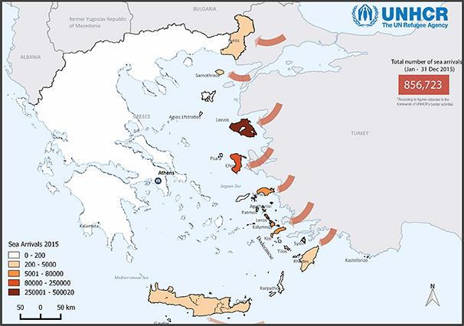
Refugees and immigration
One of the participant teachers is a volunteer with Action Aid and presents the immigration issue. There are about 7.000 refugees and migrants on Lesvos with regular arrivals almost every day.

Slide 10
SOURCEs: Wikipedia, unhcr
Participants-teachers in the Erasmus+ programme,
“Reading The City”, 3-9 September 2017:
Chalkia Maria
Kefala Marina
Kleidaras George
Tsagkari Theodora

